Slide 1
Project Summary
09/13/2021

Slide 2
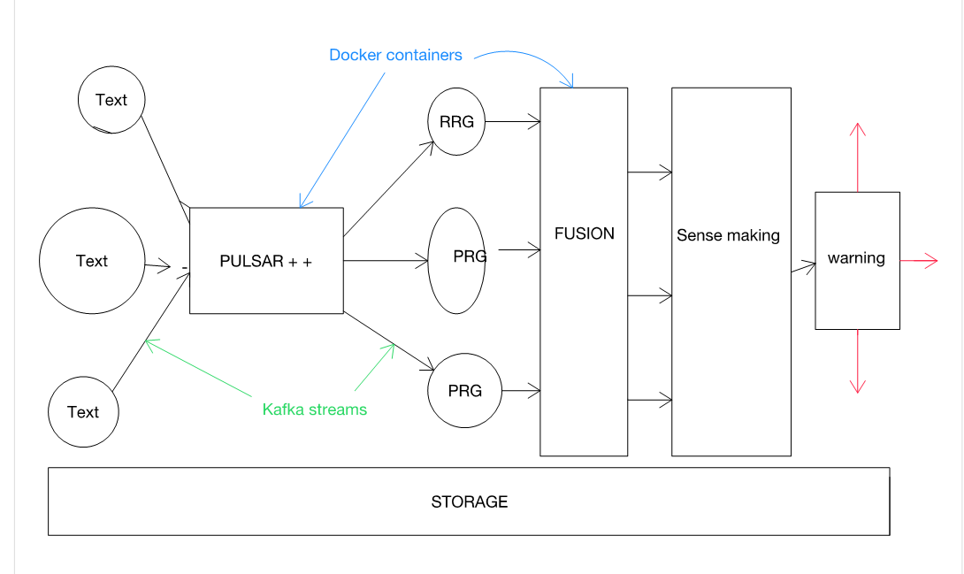
Big Picture
Automatic streaming

Slide 3
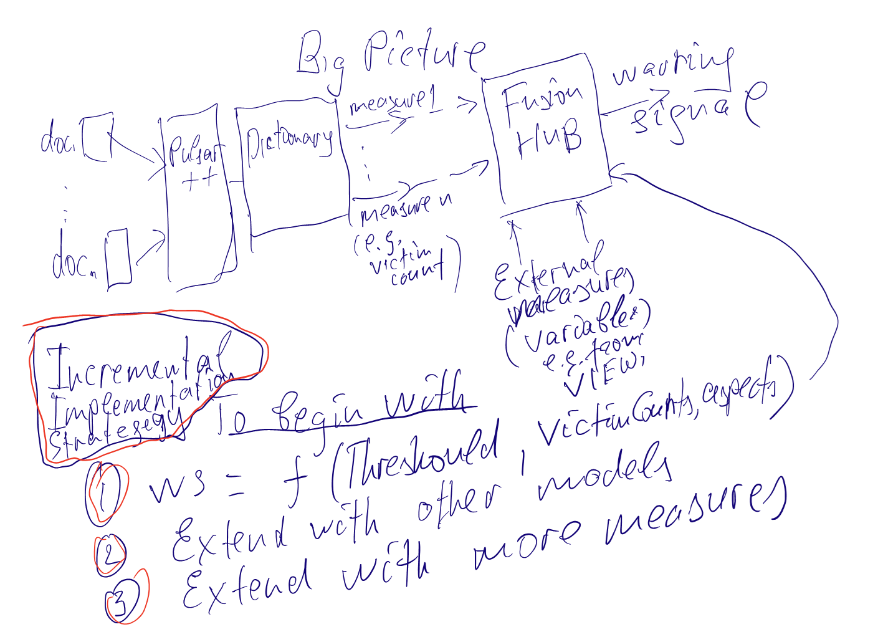
Big Picture: implementation strategy

Slide 4
Do/Done list
Doc/text → key word/dictionary (PULSAR)
Automate streaming: Kafka with Docker
Data collection and storage: data warehouse
Data Visualization
Data Fusion

Slide 5
Do/done list
Doc/text → key word/dictionary (PULSAR)
Prof. Michael Colaresi
{
"0": {
"Location": {
"Country": "Algeria",
"LowestLevel": [],
"LL_Name": [],
"Latitude": [],
"Longtidue": []
},
"Time": {
"Year": 1999,
"Mounth": [],
"Day": []
},
"Sentence": {
"1999 Algeria President
Abdelaziz Bouteflika was elected in
April to a 5 year term": {
"Tags": {
"JPr": "",
"NEG": "",
"JGT": "",
"JQu": "",
"SAVP": "",
"GAHR": "",
"Victims": "",
"Victims+GAHR": "",
"Perpetrator": "",
"TaTVP": ""
},
"Aspect": "Section Political Election RecentElection",
"Valence": {}
}
},
"Metadata": {
"Report": "US State Department",
"Section": [],
"Paragraph": [],
"Sentence": []
}
},

Slide 6
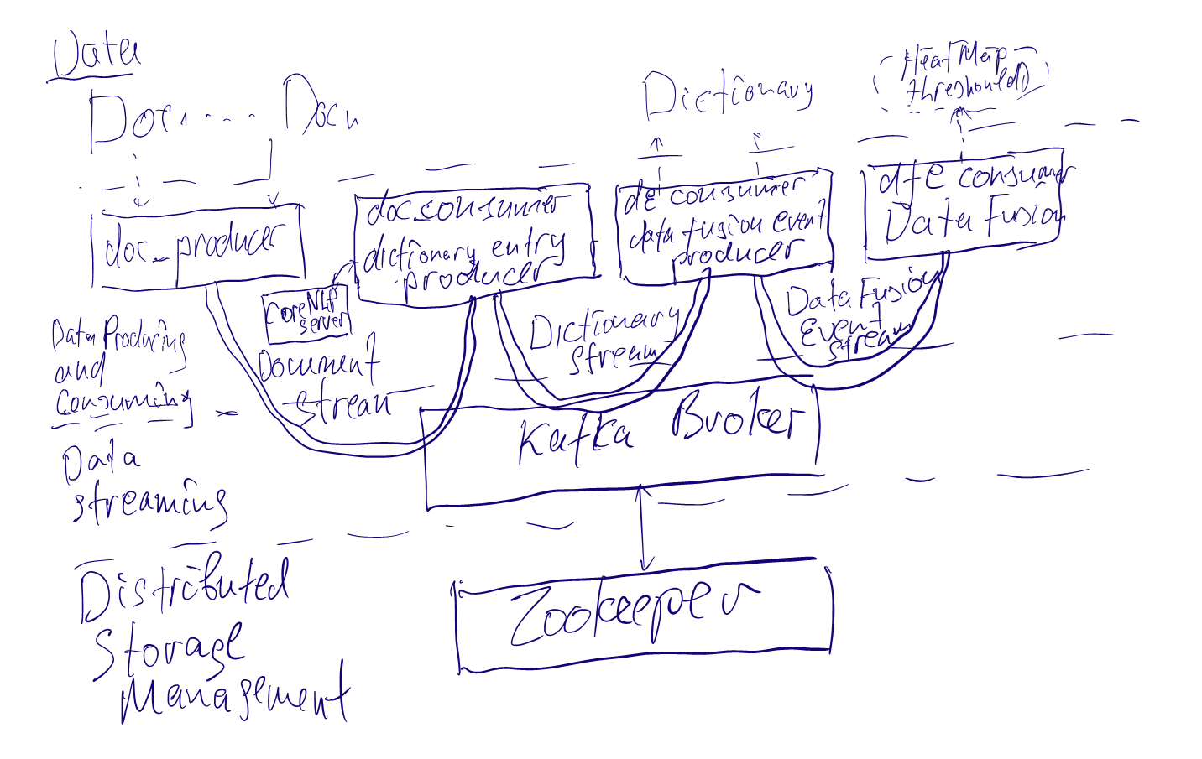
Do/Done list
Automate streaming: Kafka with Docker

Slide 7
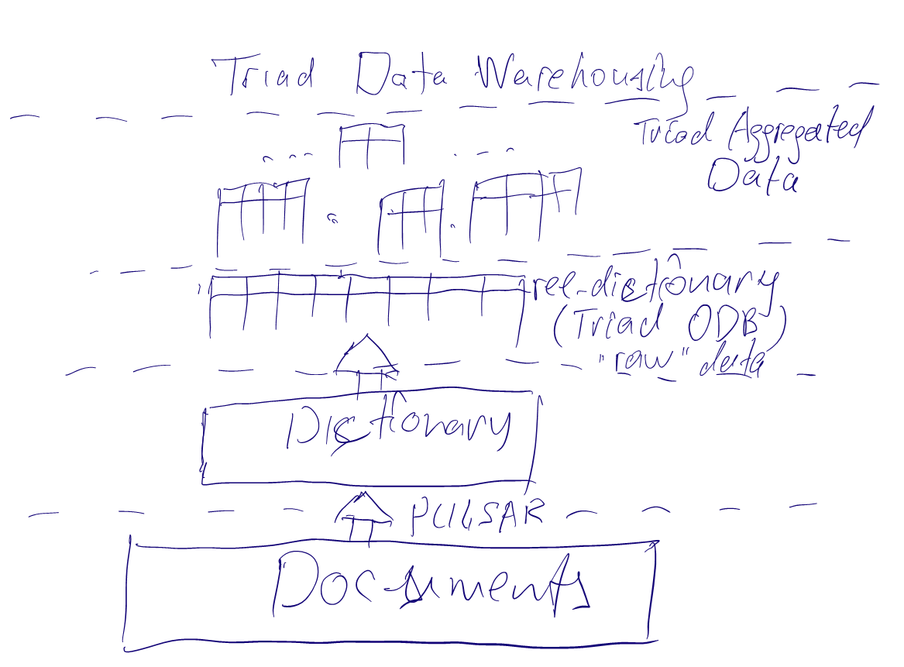
Do/Done list
Data collection and storage: data warehouse

Slide 8
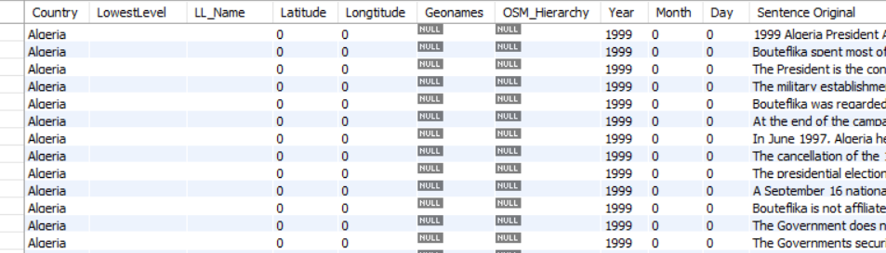
Do/Done list
Data collection and storage: data warehouse
Using MySQL database to storage PULSAR output dictionary
30 columns

Slide 9
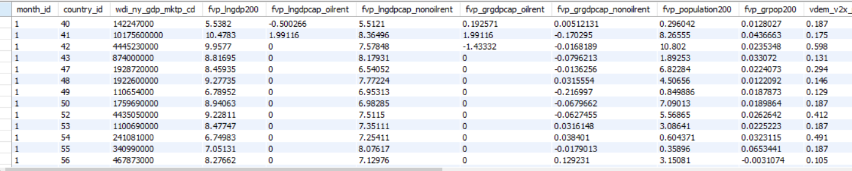
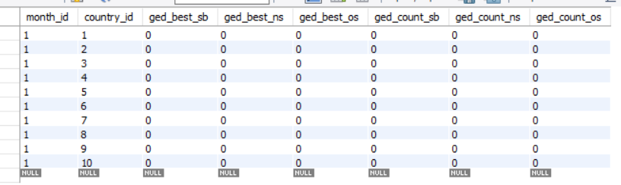
Do/Done list
Data collection and storage: data warehouse
Store and Apply Views data
Views independent data
Views ged_cm data (UCDP Georeferenced Event Dataset)

Slide 10
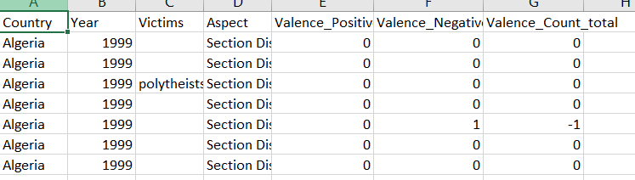
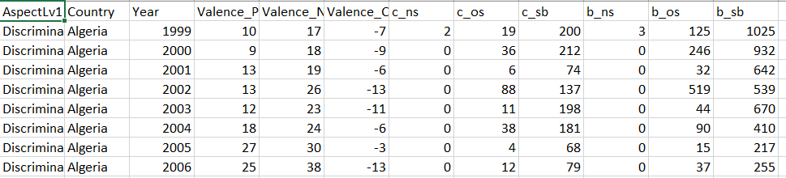
Do/Done list
Data collection and storage: data warehouse
Aggregated data
1. PULSAR aggregated Aspect data
2. Aggregated PULSAR Aspect + Views ged data

Slide 11
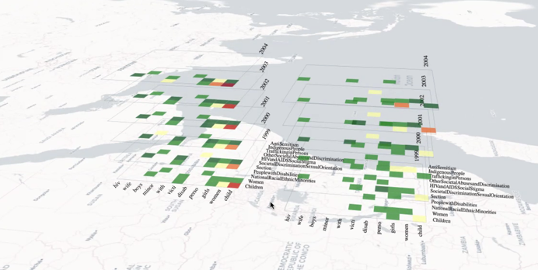
Do/Done list
Data Visualization
Prof. Panos Chrysanthis, Xiaozhong Zhang

Slide 12
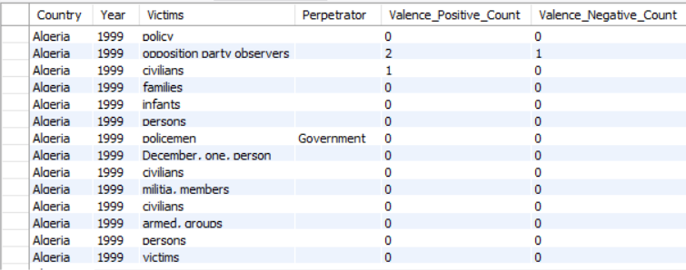
Do/Done list
Data Fusion
Data cleaning
In PULSAR
After PULSAR
Data Utilization
Sense making and warning?

Slide 13
Big Picture
Automatic streaming
Interpretable logical learning

Slide 14
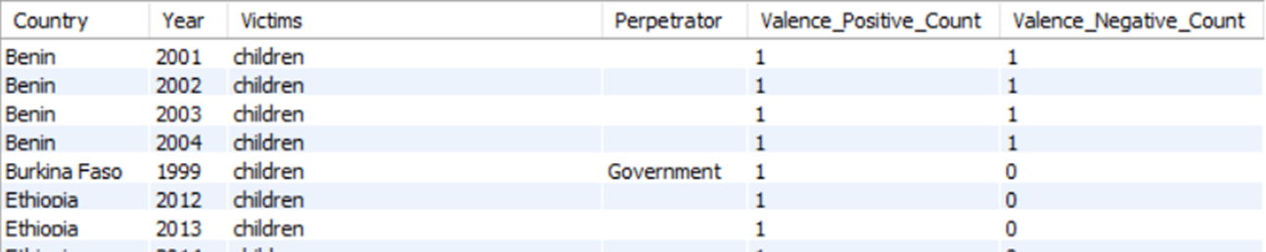
Simulation on Tsetlin Machine (TM)
Notes:
select Country, Year, Victims, Perpetrator, Valence_Positive_Count, Valence_Negative_Countfrom pulsar_2where Victims != '' ;

Slide 15
Simulation on Tsetlin Machine (TM)
Data set 1 with rules
Simulate: one sentence
literals
1 Perpetrator: government (0 means no perpetrator, 1 means government)
1 victims: children (0 means no victims, 1 means children)
violation: (0 means no violation, 1 means there is violation)
Output: (1: severe; 0: not severe)
Rules
If government and children and violation → severe
Otherwise -> not severe
Summary: AND
All possibility:
government | children | violation | not government | not children | not violation |  | severe
1 | 1 | 1 | 0 | 0 | 0 |  | 1
1 | 1 | 0 | 0 | 0 | 1 |  | 0
1 | 0 | 1 | 0 | 1 | 0 |  | 0
1 | 0 | 0 | 0 | 1 | 1 |  | 0
0 | 1 | 1 | 1 | 0 | 0 |  | 0
0 | 1 | 0 | 1 | 0 | 1 |  | 0
0 | 0 | 1 | 1 | 1 | 0 |  | 0
0 | 0 | 0 | 1 | 1 | 1 |  | 0

Slide 16
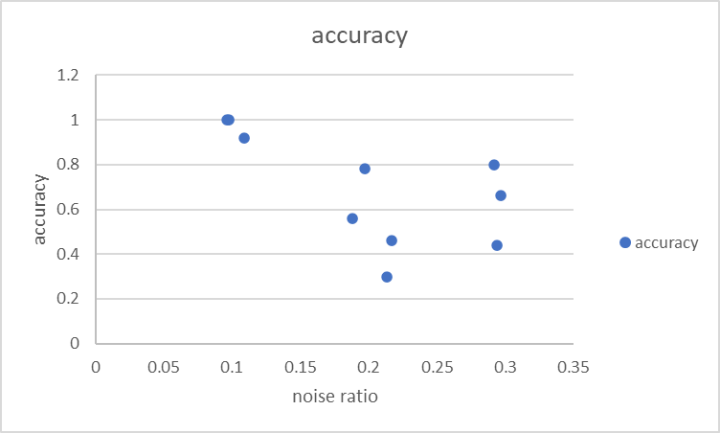
Simulation on Tsetlin Machine (TM)
Data set 1 with rules
Result: pred_accuracy = 1
Data set with noise
Set up % noise in training set, but not test set

Slide 17
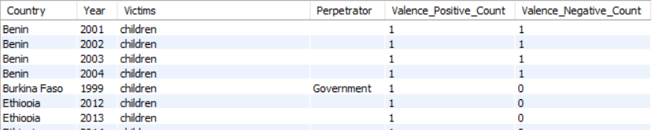
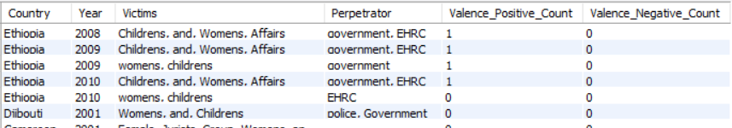
Simulation on Tsetlin Machine (TM)
Notes:
select Country, Year, Victims, Perpetrator, Valence_Positive_Count, Valence_Negative_Countfrom pulsar_2where Victims like '%children%' and Victims like '%women%’;
select Country, Year, Victims, Perpetrator, Valence_Positive_Count, Valence_Negative_Countfrom pulsar_2where Victims like 'children’;
select Country, Year, Victims, Perpetrator, Valence_Positive_Count, Valence_Negative_Countfrom pulsar_2where Victims like 'women';

Slide 18
Simulation on Tsetlin Machine (TM)
Data set 2-1 with rules
Simulate: one sentence, a little bit more complicated situation
librals
1 Perpetrator: government (0 or 1)
2 victims:
children (0 or 1)
Women (0 or 1)
violation: (0 means no violation, 1 means there is violation)
Output: (1: severe; 0: not severe)
Rules
if govern AND Children AND violations then severe: [1 1 0 1 0 0 1 0] -> 1

Slide 19
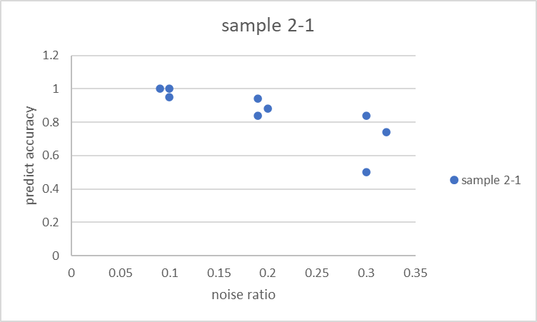
Simulation on Tsetlin Machine (TM)
Data set 2-1 with rules
Result: pred_accuracy = 1
Data set with noise
Set up % noise in training set, but not test set
sample 2-1
noise ratio (1000 runs) | 0.09 | 0.1 | 0.1 | 0.2 | 0.19 | 0.19 | 0.3 | 0.32 | 0.3
accuracy | 1 | 1 | 0.95 | 0.88 | 0.94 | 0.84 | 0.5 | 0.74 | 0.84

Slide 20
Simulation on Tsetlin Machine (TM)
Data set 2-2 with rules
Simulate: one sentence, a little bit more complicated situation
librals
1 Perpetrator: government (0 or 1)
2 victims:
children (0 or 1)
Women (0 or 1)
violation: (0 means no violation, 1 means there is violation)
Output: (1: severe; 0: not severe)
Rules
If govern AND Women AND violations then severe: [1 0 1 1 0 1 0 0] -> 1

Slide 21
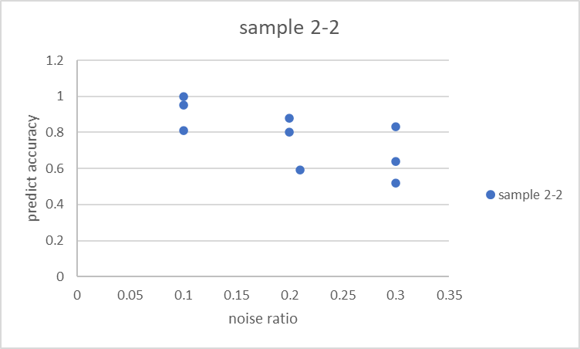
Simulation on Tsetlin Machine (TM)
Data set 2-2 with rules
Result: pred_accuracy = 1
Data set with noise
Set up % noise in training set, but not test set
sample 2-2
noise ratio (1000 runs) | 0.1 | 0.1 | 0.1 | 0.2 | 0.21 | 0.2 | 0.3 | 0.3 | 0.3
accuracy | 1 | 0.81 | 0.95 | 0.8 | 0.59 | 0.88 | 0.52 | 0.64 | 0.83

Slide 22
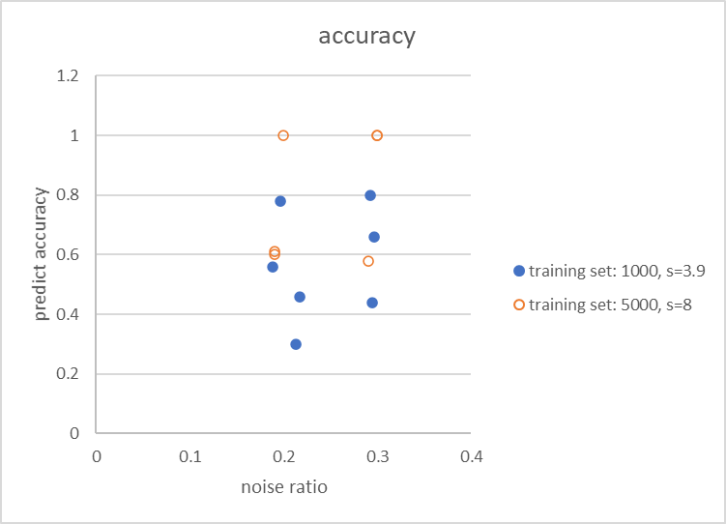
Simulation on Tsetlin Machine (TM)
Data set with noise
Using larger s (memorize ratio) can improve the accuracy when having noise in the training set
It performs better but not quite stable, still depending on the training set distribution even with large training set (5000)
sample 2-2
noise ratio (1000 runs) | 0.1 | 0.1 | 0.1 | 0.2 | 0.21 | 0.2 | 0.3 | 0.3 | 0.3
accuracy | 1 | 0.81 | 0.95 | 0.8 | 0.59 | 0.88 | 0.52 | 0.64 | 0.83
Sample 1 s=8, n=5000 |  |  |  |  | 0.19 | 0.2 | 0.19 | 0.3 | 0.3 | 0.29
noise ratio |  |  |  |  | 0.61 | 1 | 0.6 | 1 | 1 | 0.58
Notes:
Keep s = 3.9, increase training set
Keep training set, increasing s to 4.5
Each 5 runs for average

Slide 23
Simulation on Tsetlin Machine (TM)
Data set 2-3 with rules
Simulate: one sentence, a little bit more complicated situation
librals
1 Perpetrator: government (0 or 1)
2 victims:
children (0 or 1)
Women (0 or 1)
violation: (0 means no violation, 1 means there is violation)
Output: (1: severe; 0: not severe)
Rules
if govern AND Children AND violations then severe: [1 1 0 1 0 0 1 0] -> 1
OR
If govern AND Women AND violations then severe: [1 0 1 1 0 1 0 0] -> 1

Slide 24
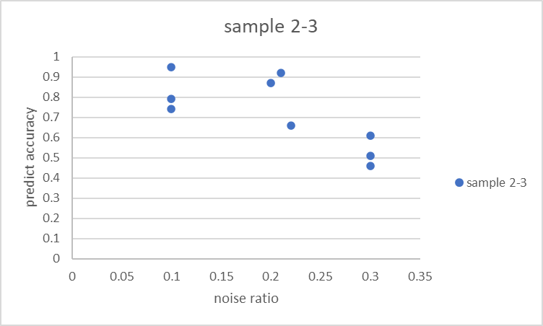
Simulation on Tsetlin Machine (TM)
Data set 2-3 with rules
Result: pred_accuracy = 1
Data set with noise
Set up % noise in training set, but not test set
sample 2-3
noise ratio (1000 runs) | 0.1 | 0.1 | 0.1 | 0.22 | 0.2 | 0.21 | 0.3 | 0.3 | 0.3
accuracy | 0.95 | 0.79 | 0.74 | 0.66 | 0.87 | 0.92 | 0.51 | 0.46 | 0.61

Slide 25
Simulation on Tsetlin Machine (TM)
Data set 2 with rules
Simulate: one sentence, a little bit more complicated situation
librals
1 Perpetrator: government (0 or 1)
2 victims:
children (0 or 1)
Women (0 or 1)
violation: (0 means no violation, 1 means there is violation)
Output: (1: severe; 0: not severe)
Rules
if govern AND Children AND violations then severe: [1 1 0 1 0 0 1 0] -> 1
If govern AND Women AND violations then severe: [1 0 1 1 0 1 0 0] -> 1
If govern AND Women AND Children AND violations then severe : [1 1 1 1 0 0 0 0] -> 1
if govern AND violations then NOT severe: [1 0 0 1 0 1 1 0] → 0
Set output = 0
If government = 1 then
if violation then
if children + women >= 1 then # either children or women or both
output = 1

Slide 26
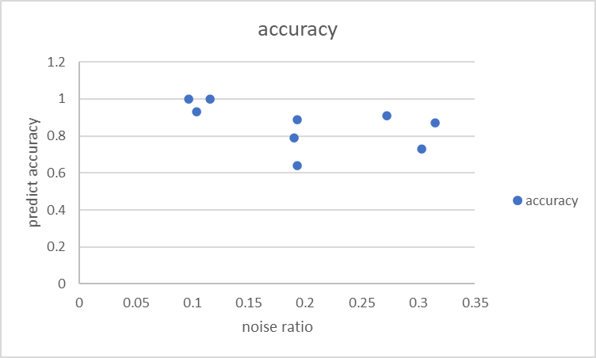
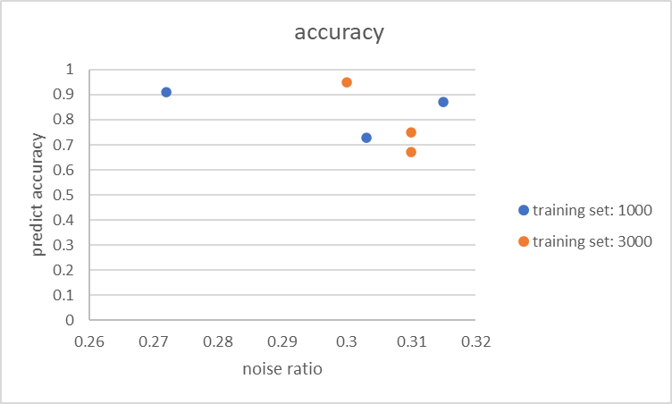
Simulation on Tsetlin Machine (TM)
Data set 2-4 with rules
Result: pred_accuracy = 1
Data set with noise
Set up % noise in training set, but not test set

Slide 27
Simulation on Tsetlin Machine (TM)
Data set 3 with rules
Simulate: aggregated situation
librals
1 Perpetrator: government (0 or 1)
2 victims:
children (0 or 1)
Women (0 or 1)
2 violation categories:
# of violations: 1 – 10: (0 or 1)
# of violations: >10: (0 or 1)
Can NOT both be 1
Output: (1: severe; 0: not severe)
Rules
if govern AND Children AND # of violations>10 then severe: [1 1 0 0 1 0 0 1 1 0] -> 1
If govern AND Women AND # of violations > 10 then severe: [1 0 1 0 1 0 1 0 1 0] -> 1
If govern AND Women AND Children AND # of violations > 10 then severe : [1 1 1 0 1 0 0 0 1 0] -> 1
If govern AND children AND not Women AND # of violations 1-10 then severe: [1 1 0 1 0 0 0 1 0 1] -> 1
If govern AND women AND not children AND # of violations 1-10 then severe: [1 0 1 1 0 0 1 0 0 1] -> 1
Set output = 0
If government = 1 then
if violation>10 = 1 then
if children + women >= 1 then # either children or women or both
output = 1
else if violation 1-10 = 1 then
if children + women = 1 then # either children or women but can NOT both
output = 1

Slide 28
Simulation on Tsetlin Machine (TM)
Sample2 results:
pred_accuracy = [0.9, 0.8, 0.84, 0.82, 0.94]:
m = 20 # total number of clauses
mpn = int(m/2) # nmber of positive/negative clauses
# number of input variables (features); 2*o is a number of literals (= number of TAs)
o = 5
N = 100 # number of TA states
T = 15
s = 3.9
num_of_train_runs = 1000
num_of_test_runs = 50
M = 10 then pred_accuracy = [0.86, 0.9, 0.84, 0.58, 0.78]
N = 120 then pred_accuracy = [0.9, 0.92, 0.7, 0.82, 0.86]
Num_of_train_rums = 2000 then pred_accuracy = [0.84, 0.9, 0.76, 0.94, 0.84]
Error:
If govern AND children AND not Women AND # of violations 1-10 then severe but predict Not
Inlits: [1 1 0 1 0 0 0 1 0 1] , output: 1 , Predict: 0
If govern AND women AND not children AND # of violations 1-10 then severe but predict NOT
inlits: [1 0 1 1 0 0 1 0 0 1] , output: 1 , Predict: 0
If no specified victims, should no severe, but predict YES
inlits: [1 0 0 0 1 0 1 1 1 0] , output: 0 , Predict: 1

Slide 29
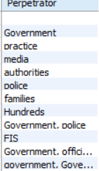
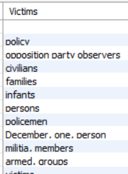
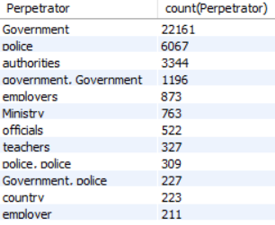
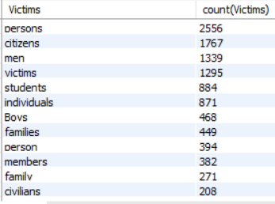
Properties of PULSAR
Perpetrator:
# of distinct Perpetrator: 1501 (1502-1)
May need select some helpful perpetrators for Tsetlin Machine
Victims:
# of distinct victims: 3153 (3153-1)
May need select some helpful perpetrators for Tsetlin Machine
Most frequently Perpetrator and Victims
Notes:
Merge (persons, citizens, individuals, civilians, person)
Merge(boys, boy, Boy, Boys, girls, ect)
? Think about time and location
? Go with aggregation data
Time from ? To ?
Country, from, to, govern_p, police_p, Person_v, children_v

Slide 30
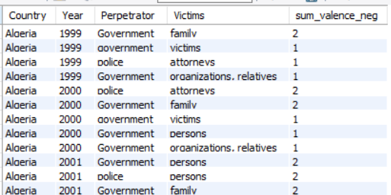
Next step: from data warehouse to Tsetlin
Perpetrators: Government, police
Victims: Person, Children
Person may include: [person, persons, citizen, citizens, men, women, individuals, etc]
Children may include: [child, children, childrens, boys, girls, family, students, etc]
Category: Perpetrator-Victim pairs
Go-Per, Go-Chi, Po-Per, Go-Chi
In each category, has two valence level: less than 5, equal or more than 5
Country | Year | Go-Per |  | Go-Chi |  | Po-Per |  | Go-Chi |  | Severity
 |  | <5 | >=5 | <5 | >=5 | <5 | >=5 | <5 | >=5
Aloeria | 1999 | 0 | 0 | 1 | 0 | 0 | 0 | 0 | 0
Aloeria | 2000 | 1 | 0 | 1 | 0 | 0 | 0 | 0 | 0
Aloeria | 2001 | 1 | 0 | 1 | 0 | 1 | 0 | 0 | 0
Notes:
Merge (persons, citizens, individuals, civilians, person)
Merge(boys, boy, Boy, Boys, girls, ect)
? Think about time and location
? Go with aggregation data
Time from ? To ?
Country, from, to, govern_p, police_p, Person_v, children_v
1. DW: Country, Year, Perpetrator, Victims, count(viol)
2. Table 1.1 “dictionary” in the chapter Property (G-P, P-P, G-C, P-C, severity) and Values (ranges)
3. Table 1.0 Country, Year, Gover-Person, Police-Person, Gover-Children, Police-Children
4. Table 1.2 with properties from Table 1.1: G-P, P-P, G-C, P-C, severity
5. Table 1.3 boolinised version of Table 1.2

Slide 31
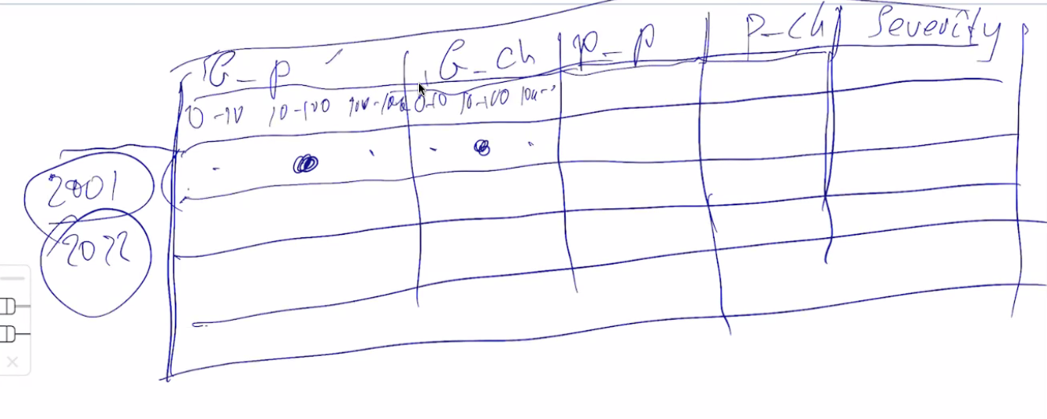
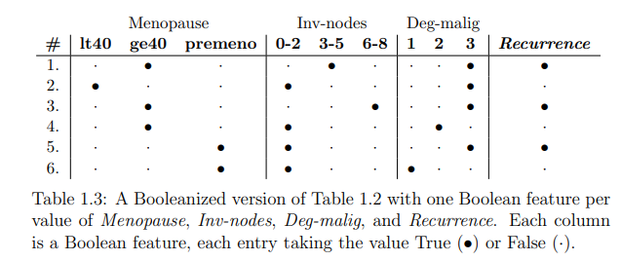
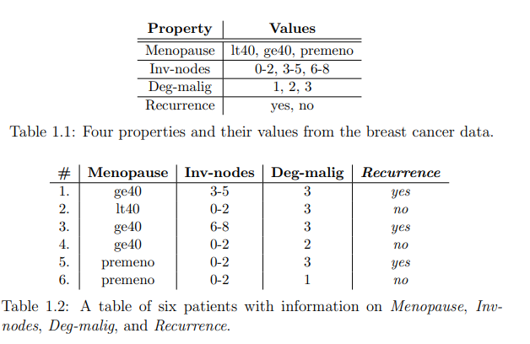
Next step: from data warehouse to Tsetlin
Perpetrator:
# of distinct Perpetrator: 1501 (1502-1)
May need select some helpful perpetrators for Tsetlin Machine
Victims:
# of distinct victims: 3153 (3153-1)
May need select some helpful perpetrators for Tsetlin Machine
Most frequently Perpetrator and Victims
Notes:
Merge (persons, citizens, individuals, civilians, person)
Merge(boys, boy, Boy, Boys, girls, ect)
? Think about time and location
? Go with aggregation data
Time from ? To ?
Country, from, to, govern_p, police_p, Person_v, children_v
1. DW: Country, Year, Perpetrator, Victims, count(viol)
2. Table 1.1 “dictionary” in the chapter Property (G-P, P-P, G-C, P-C, severity) and Values (ranges)
3. Table 1.0 Country, Year, Gover-Person, Police-Person, Gover-Children, Police-Children
4. Table 1.2 with properties from Table 1.1: G-P, P-P, G-C, P-C, severity
5. Table 1.3 boolinised version of Table 1.2

Slide 32
Next step: from data warehouse to Tsetlin
Rules:
If one P-V par >=5, then severe
Else If more than two pairs exist, then severe
if ((inv[1] + inv[3] + inv[5] + inv[7] >= 1) or (inv[0] + inv[2] + inv[4] + inv[6] >= 2)):
output = 1
Country | Year | Go-Per |  | Go-Chi |  | Po-Per |  | Go-Chi |  | Severity
 |  | <5 | >=5 | <5 | >=5 | <5 | >=5 | <5 | >=5
Aloeria | 1999 | 0 | 0 | 1 | 0 | 0 | 0 | 0 | 0 | 0
Aloeria | 2000 | 1 | 0 | 1 | 0 | 0 | 0 | 0 | 0 | 1
Aloeria | 2001 | 1 | 0 | 1 | 0 | 1 | 0 | 0 | 0 | 1
Notes:
Merge (persons, citizens, individuals, civilians, person)
Merge(boys, boy, Boy, Boys, girls, ect)
? Think about time and location
? Go with aggregation data
Time from ? To ?
Country, from, to, govern_p, police_p, Person_v, children_v
1. DW: Country, Year, Perpetrator, Victims, count(viol)
2. Table 1.1 “dictionary” in the chapter Property (G-P, P-P, G-C, P-C, severity) and Values (ranges)
3. Table 1.0 Country, Year, Gover-Person, Police-Person, Gover-Children, Police-Children
4. Table 1.2 with properties from Table 1.1: G-P, P-P, G-C, P-C, severity
5. Table 1.3 boolinised version of Table 1.2

Slide 33
Next step: from data warehouse to Tsetlin
Simulation Results:
Strong false positive with 1000 or 10000 training set
[0 0 0 0 1 0 0 0 1 1 1 1 0 1 1 1] , output: 0 , Predict: 1
[1 0 0 0 0 0 0 0 0 1 1 1 1 1 1 1] , output: 0 , Predict: 1
[0 0 0 0 0 0 0 0 1 1 1 1 1 1 1 1], , output: 0 , Predict: 1
As the training set is randomly generated, may need add more cases for output = 0
If randomly generate the training set. Most of them are 1 output
Also have false negative:
[1 0 0 1 1 0 1 0 0 1 1 0 0 1 0 1] , output: 1 , Predict: 0
[1 0 0 1 1 0 0 1 0 1 1 0 0 1 1 0] , output: 1 , Predict: 0
How to adjust the parameters?
m = 20 # total number of clauses
mpn = int(m/2) # nmber of positive/negative clauses
# number of input variables (features); 2*o is a number of literals (= number of TAs)
o = 8
N = 100 # number of TA states
T = 15
# larger s with more train runs may improve the accuracy when having noise
s = 3.9
Notes:
Merge (persons, citizens, individuals, civilians, person)
Merge(boys, boy, Boy, Boys, girls, ect)
? Think about time and location
? Go with aggregation data
Time from ? To ?
Country, from, to, govern_p, police_p, Person_v, children_v
1. DW: Country, Year, Perpetrator, Victims, count(viol)
2. Table 1.1 “dictionary” in the chapter Property (G-P, P-P, G-C, P-C, severity) and Values (ranges)
3. Table 1.0 Country, Year, Gover-Person, Police-Person, Gover-Children, Police-Children
4. Table 1.2 with properties from Table 1.1: G-P, P-P, G-C, P-C, severity
5. Table 1.3 boolinised version of Table 1.2

Slide 34
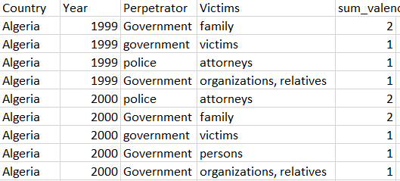
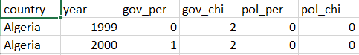
Next step: from data warehouse to Tsetlin
Real data from PULSAR data warehouse
get aggregated data:
Agg_Perp_Vic_for_TsetlinM.csv (2069 rows)
from agg data to pair data
Consider upper case and lower case
Consider multiple perp and vict, split by ‘,’
P_v_pair.csv (311 rows)
from pair data to Boolean data
P_v_bool.csv
G-P-1: govern-person-<5
G-P-2: govern-person->=5
N-G-P-1: Not govern-person-<5 (used in Tsetlin Machine)
Logical interpretation view
Notes:
Get aggregated data:
D:\jiawei\research\Research\PULSAR\vladimir\TsetlinMachine\TMMatrixApproach\Python\Agg_Perp_Vic_for_TsetlinM.csv
select Country, Year, Perpetrator, Victims, sum(Valence_Negative_Count) as sum_valence_negfrom pulsar_2where Perpetrator != '' and Victims != '' and Valence_Negative_Count >= 1group by Country, Year, Perpetrator, Victimsorder by Country, Year, sum_valence_neg desc;
2. From agg data to pair data
D:\jiawei\research\Research\PULSAR\vladimir\TsetlinMachine\TMMatrixApproach\Python\pulsarToPVPair.py
3. Form pair data to Boolean data
D:\jiawei\research\Research\PULSAR\vladimir\TsetlinMachine\TMMatrixApproach\Python\p_v_bool.csv
D:\jiawei\research\Research\PULSAR\vladimir\TsetlinMachine\TMMatrixApproach\Python\pairToBool.py

Slide 35
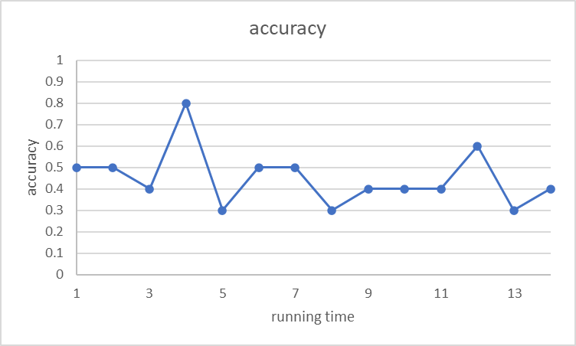
Next step: from data warehouse to Tsetlin
Result:
Accuracy
Randomly select 301 for training, and the remaining 10 for testing
Notes:
Get aggregated data:
D:\jiawei\research\Research\PULSAR\vladimir\TsetlinMachine\TMMatrixApproach\Python\Agg_Perp_Vic_for_TsetlinM.csv
select Country, Year, Perpetrator, Victims, sum(Valence_Negative_Count) as sum_valence_negfrom pulsar_2where Perpetrator != '' and Victims != '' and Valence_Negative_Count >= 1group by Country, Year, Perpetrator, Victimsorder by Country, Year, sum_valence_neg desc;
2. From agg data to pair data
D:\jiawei\research\Research\PULSAR\vladimir\TsetlinMachine\TMMatrixApproach\Python\pulsarToPVPair.py
3. Form pair data to Boolean data
D:\jiawei\research\Research\PULSAR\vladimir\TsetlinMachine\TMMatrixApproach\Python\p_v_bool.csv
D:\jiawei\research\Research\PULSAR\vladimir\TsetlinMachine\TMMatrixApproach\Python\pairToBool.py
4. Load Boolean data and using Tsetlin Machine
D:\jiawei\research\Research\PULSAR\vladimir\TsetlinMachine\TMMatrixApproach\Python\sample4_2.py

Slide 36
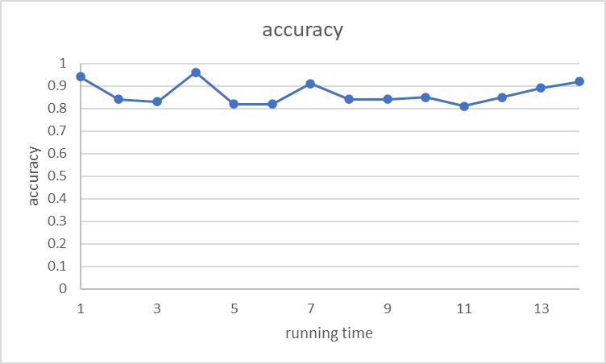
Next step: from data warehouse to Tsetlin Machine
Result:
Accuracy (same data 311 records for both train and test)
Notes:
Get aggregated data:
D:\jiawei\research\Research\PULSAR\vladimir\TsetlinMachine\TMMatrixApproach\Python\Agg_Perp_Vic_for_TsetlinM.csv
select Country, Year, Perpetrator, Victims, sum(Valence_Negative_Count) as sum_valence_negfrom pulsar_2where Perpetrator != '' and Victims != '' and Valence_Negative_Count >= 1group by Country, Year, Perpetrator, Victimsorder by Country, Year, sum_valence_neg desc;
2. From agg data to pair data
D:\jiawei\research\Research\PULSAR\vladimir\TsetlinMachine\TMMatrixApproach\Python\pulsarToPVPair.py
3. Form pair data to Boolean data
D:\jiawei\research\Research\PULSAR\vladimir\TsetlinMachine\TMMatrixApproach\Python\p_v_bool.csv
D:\jiawei\research\Research\PULSAR\vladimir\TsetlinMachine\TMMatrixApproach\Python\pairToBool.py
4. Load Boolean data and using Tsetlin Machine
D:\jiawei\research\Research\PULSAR\vladimir\TsetlinMachine\TMMatrixApproach\Python\sample4_2.py

Slide 37
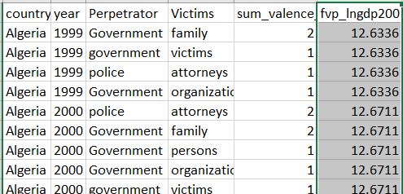
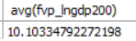
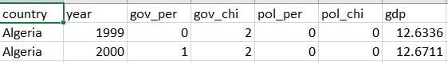
Next step: from data warehouse to Tsetlin Machine
Find the relationship between
PULSAR P-V paris and some Views project data
such as GDP per capita (lngdp200)
Poor = 1 if lngdp200 < avg (10.1)
Social Health → Social Wealth (relationship)
Result:
Accuracy: ~0.54
Possible Reason:
the amount of training set is small (total data set is 279)
No strong correlation with the current parameters setting
Social health → Social wealth
Logical interpretation view
Notes:
Get aggregated data:
D:\jiawei\research\Research\PULSAR\vladimir\TsetlinMachine\TMMatrixApproach\Python\Agg_Perp_Vic_for_TsetlinM.csv
select Country, Year, Perpetrator, Victims, sum(Valence_Negative_Count) as sum_valence_negfrom pulsar_2where Perpetrator != '' and Victims != '' and Valence_Negative_Count >= 1group by Country, Year, Perpetrator, Victimsorder by Country, Year, sum_valence_neg desc;
2. From agg data to pair data
D:\jiawei\research\Research\PULSAR\vladimir\TsetlinMachine\TMMatrixApproach\Python\pulsarToPVPair.py
3. Form pair data to Boolean data
D:\jiawei\research\Research\PULSAR\vladimir\TsetlinMachine\TMMatrixApproach\Python\p_v_bool.csv
D:\jiawei\research\Research\PULSAR\vladimir\TsetlinMachine\TMMatrixApproach\Python\pairToBool.py
4. Load Boolean data and using Tsetlin Machine
D:\jiawei\research\Research\PULSAR\vladimir\TsetlinMachine\TMMatrixApproach\Python\sample4_2.py

Slide 38
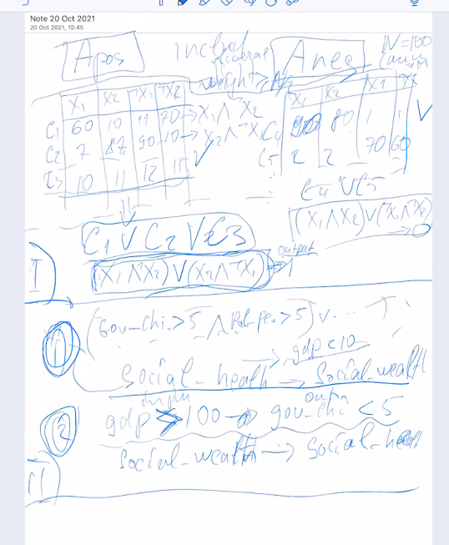
Next step: from data warehouse to Tsetlin Machine
Apos after train:
Gp1, gp2, gc1, gc2, pp1, pp2, pc1, pc2
[[0 0 0 0 0 1 0 0 0 1 0 0 1 0 0 1] = pp2 and not gp2 and not pp1 and not pc2
[0 0 1 0 0 0 0 0 0 1 0 0 1 0 0 0] = gc1 and not gp2 and not pp1
[0 0 0 0 0 1 0 0 0 0 0 0 0 1 0 0]
[1 0 0 0 0 0 0 0 1 0 0 0 0 0 0 1]
[0 0 0 0 1 0 0 0 0 0 1 0 1 0 1 0]
[0 0 0 1 0 0 0 0 0 0 1 0 0 0 1 0]
[0 0 0 0 1 1 0 0 1 0 0 0 0 0 1 0]
[0 1 0 0 0 0 0 0 0 1 0 0 0 0 0 0]
[0 0 0 1 1 0 0 0 0 0 0 0 0 0 0 0]
[1 1 1 0 0 0 0 0 0 0 1 0 0 1 0 0]]
Notes:
Get aggregated data:
D:\jiawei\research\Research\PULSAR\vladimir\TsetlinMachine\TMMatrixApproach\Python\Agg_Perp_Vic_for_TsetlinM.csv
select Country, Year, Perpetrator, Victims, sum(Valence_Negative_Count) as sum_valence_negfrom pulsar_2where Perpetrator != '' and Victims != '' and Valence_Negative_Count >= 1group by Country, Year, Perpetrator, Victimsorder by Country, Year, sum_valence_neg desc;
2. From agg data to pair data
D:\jiawei\research\Research\PULSAR\vladimir\TsetlinMachine\TMMatrixApproach\Python\pulsarToPVPair.py
3. Form pair data to Boolean data
D:\jiawei\research\Research\PULSAR\vladimir\TsetlinMachine\TMMatrixApproach\Python\p_v_bool.csv
D:\jiawei\research\Research\PULSAR\vladimir\TsetlinMachine\TMMatrixApproach\Python\pairToBool.py
4. Load Boolean data and using Tsetlin Machine
D:\jiawei\research\Research\PULSAR\vladimir\TsetlinMachine\TMMatrixApproach\Python\sample4_2.py

Slide 39

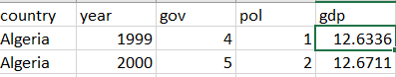
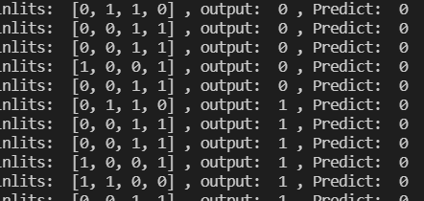
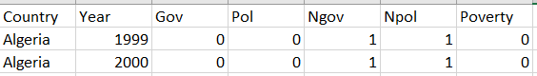
Next step: from data warehouse to Tsetlin Machine
Find the relationship between
PULSAR Perpetrator to GDP
Only two perpetrations: government and police
Avg of violence as threshold to set 0 or 1
Avg_government_vio = 6.3
Avg_police_vio = 2.3
such as GDP per capita (lngdp200)
Poor = 1 if lngdp200 < avg (10.1)
Social Health → Social Wealth (relationship)
Result:
Accruracy: ~0.54 (same as previous one)
Possible Reason:
the amount of training set is small (total data set is 279)
No strong correlation with the current parameters setting
Social health → Social wealth
Notes:
Using percentile instead of avg. very high for perpetrator vs very low for gdp
Get aggregated data:
D:\jiawei\research\Research\PULSAR\vladimir\TsetlinMachine\TMMatrixApproach\Python\Agg_Perp_Vic_for_TsetlinM.csv
select Country, Year, Perpetrator, Victims, sum(Valence_Negative_Count) as sum_valence_negfrom pulsar_2where Perpetrator != '' and Victims != '' and Valence_Negative_Count >= 1group by Country, Year, Perpetrator, Victimsorder by Country, Year, sum_valence_neg desc;
2. From agg data to pair data
D:\jiawei\research\Research\PULSAR\vladimir\TsetlinMachine\TMMatrixApproach\Python\pulsarToPVPair.py
3. Form pair data to Boolean data
D:\jiawei\research\Research\PULSAR\vladimir\TsetlinMachine\TMMatrixApproach\Python\p_v_bool.csv
D:\jiawei\research\Research\PULSAR\vladimir\TsetlinMachine\TMMatrixApproach\Python\pairToBool.py
4. Load Boolean data and using Tsetlin Machine
D:\jiawei\research\Research\PULSAR\vladimir\TsetlinMachine\TMMatrixApproach\Python\sample4_2.py

Slide 40
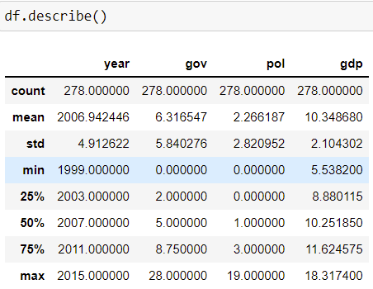
Next step: from data warehouse to Tsetlin Machine
Find the relationship between
PULSAR Perpetrator to GDP
Only two perpetrations: government and police
Percentile as threshold to set 0 or 1
75% government_vio = 8.75
75%_police_vio = 3
such as GDP per capita (lngdp200)
Poor = 1 if lngdp200 < 25% (8.88)
Social Health → Social Wealth (relationship)
Result:
Accruracy: ~0.75 (better than previous one ~0.54)
How to improve:
Enlarge the training set
Change parameters setting
Social health → Social wealth
[[0 1 0 0]
[0 1 0 0]
[1 0 0 0]
[1 1 0 0]
[1 0 0 0]
[0 1 0 0]
[1 0 0 0]
[1 1 0 0]
[1 0 0 1]
[0 1 0 0]]
Notes:
Using percentile instead of avg. very high for perpetrator vs very low for gdp
Get aggregated data:
D:\jiawei\research\Research\PULSAR\vladimir\TsetlinMachine\TMMatrixApproach\Python\Agg_Perp_Vic_for_TsetlinM.csv
select Country, Year, Perpetrator, Victims, sum(Valence_Negative_Count) as sum_valence_negfrom pulsar_2where Perpetrator != '' and Victims != '' and Valence_Negative_Count >= 1group by Country, Year, Perpetrator, Victimsorder by Country, Year, sum_valence_neg desc;
2. From agg data to pair data
D:\jiawei\research\Research\PULSAR\vladimir\TsetlinMachine\TMMatrixApproach\Python\pulsarToPVPair.py
3. Form pair data to Boolean data
D:\jiawei\research\Research\PULSAR\vladimir\TsetlinMachine\TMMatrixApproach\Python\p_v_bool.csv
D:\jiawei\research\Research\PULSAR\vladimir\TsetlinMachine\TMMatrixApproach\Python\pairToBool.py
4. Load Boolean data and using Tsetlin Machine
D:\jiawei\research\Research\PULSAR\vladimir\TsetlinMachine\TMMatrixApproach\Python\sample4_2.py

Slide 41
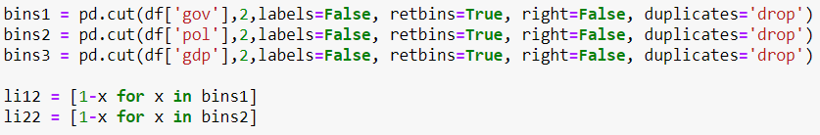
Next step: from data warehouse to Tsetlin Machine
Find the relationship between
PULSAR Perpetrator to GDP
Only two perpetrations: government and police
Using pandas.cut create two bins
For all gov, pol, and gdp
This method can be used to booleanise all numerical data
Result:
Accruracy: ~0.39
How to improve:
Change parameters setting to create bins
Social health → Social wealth
Notes:
C:\Users\J\Desktop\PULSAR_Jupyter_Notebook\PULSAR.ipynb
Get aggregated data:
D:\jiawei\research\Research\PULSAR\vladimir\TsetlinMachine\TMMatrixApproach\Python\Agg_Perp_Vic_for_TsetlinM.csv
select Country, Year, Perpetrator, Victims, sum(Valence_Negative_Count) as sum_valence_negfrom pulsar_2where Perpetrator != '' and Victims != '' and Valence_Negative_Count >= 1group by Country, Year, Perpetrator, Victimsorder by Country, Year, sum_valence_neg desc;
2. From agg data to pair data
D:\jiawei\research\Research\PULSAR\vladimir\TsetlinMachine\TMMatrixApproach\Python\pulsarToPVPair.py
3. Form pair data to Boolean data
D:\jiawei\research\Research\PULSAR\vladimir\TsetlinMachine\TMMatrixApproach\Python\p_v_bool.csv
D:\jiawei\research\Research\PULSAR\vladimir\TsetlinMachine\TMMatrixApproach\Python\pairToBool.py
4. Load Boolean data and using Tsetlin Machine
D:\jiawei\research\Research\PULSAR\vladimir\TsetlinMachine\TMMatrixApproach\Python\sample4_2.py

Slide 42
Views
Variables used:
Views independent variables
Views ged and acled violence data:
Sum of all kinds of violence
Training and Testing set
Trainning-X: (1628, 20)
Testing-X: (408, 20)
All variables (21):
'wdi_ny_gdp_mktp_cd', 'fvp_lngdp200', 'fvp_lngdpcap_oilrent',
'fvp_lngdpcap_nonoilrent', 'fvp_grgdpcap_oilrent',
'fvp_grgdpcap_nonoilrent', 'fvp_population200', 'fvp_grpop200',
'vdem_v2x_polyarchy', 'vdem_v2x_liberal', 'vdem_v2x_partip',
'fvp_fvp_demo', 'fvp_fvp_semi', 'fvp_indepyear', 'fvp_timeindep',
'fvp_timesincepreindepwar', 'fvp_timesinceregimechange',
'fvp_ssp2_edu_sec_15_24_prop', 'fvp_ssp2_urban_share_iiasa',
'acled_bins’, ‘ged_bins’

Slide 43
Views
Variables used:
Views independent variables
Views ged and acled violence data:
Sum of all kinds of violence
Then booleanized (0 or 1):
Most data based on Percentile
Some of them by hand:
Fvp_fvp_demo: using original (0 or 1)
Fvp_fvp_semi: using original (0 or 1)
Acled_count_violence: ( [0,5], (5, max])
Ged_count_violence (( [0,5], (5, max]))
Training and Testing set
Trainning-X: (1628, 20)
Testing-X: (408, 20)

Slide 44
Views
target variable:
ged
Model | F1_Score_Training | F1_Score_Test
LogisticRegression | 0.693 | 0.659
SVC | 0.750 | 0.701
GaussianNB | 0.694 | 0.660
MultinomialNB | 0.514 | 0.533
SGDClassifier | 0.518 | 0.478
KNeighborsClassifier | 0.828 | 0.826
DecisionTreeClassifier | 0.892 | 0.768
RandomForestClassifier | 0.898 | 0.802
GradientBoostingClassifier | 0.761 | 0.703
LGBMClassifier | 0.889 | 0.796
Add TM at the bottom of row

Slide 45
Views
target variable:
acled
Model | F1_Score_Training | F1_Score_Test
LogisticRegression | 0.752 | 0.701
SVC | 0.838 | 0.769
GaussianNB | 0.760 | 0.713
MultinomialNB | 0.705 | 0.695
SGDClassifier | 0.684 | 0.666
KNeighborsClassifier | 0.853 | 0.772
DecisionTreeClassifier | 0.919 | 0.759
RandomForestClassifier | 0.920 | 0.794
GradientBoostingClassifier | 0.833 | 0.784
LGBMClassifier | 0.905 | 0.787

Slide 46
Views to Tsetlin Machin
Variables used:
Views independent variables
Views ged and acled violence data:
Sum of all kinds of violence
Then categorized(up to 4):
Most data based on Percentile
Fvp_fvp_demo: using original (0 or 1)
Fvp_fvp_semi: using original (0 or 1)
Acled_count_violence: ( [0,5], (5, max])
Ged_count_violence (( [0,5], (5, max]))

Slide 47
Views to Tsetlin Machin
Target variable:
ged
Model | F1_Score_Training | F1_Score_Test
LogisticRegression | 0.717 | 0.707
SVC | 0.616 | 0.586
GaussianNB | 0.688 | 0.669
MultinomialNB | 0.629 | 0.654
SGDClassifier | 0.726 | 0.688
KNeighborsClassifier | 0.822 | 0.712
DecisionTreeClassifier | 0.957 | 0.841
RandomForestClassifier | 0.958 | 0.833
GradientBoostingClassifier | 0.851 | 0.772
LGBMClassifier | 0.959 | 0.802

Slide 48
Views to Tsetlin Machin
Target variable:
acled
Model | F1_Score_Training | F1_Score_Test
LogisticRegression | 0.792 | 0.710
SVC | 0.847 | 0.788
GaussianNB | 0.777 | 0.748
MultinomialNB | 0.719 | 0.692
SGDClassifier | 0.767 | 0.686
KNeighborsClassifier | 0.880 | 0.775
DecisionTreeClassifier | 0.980 | 0.828
RandomForestClassifier | 0.981 | 0.846
GradientBoostingClassifier | 0.899 | 0.826
LGBMClassifier | 0.974 | 0.829

Slide 49
Views to Tsetlin Machin
Variables used:
Views independent variables
Views ged and acled violence data:
Sum of all kinds of violence
Then booleanized (0 or 1):
Most data based on Percentile
Some of them by hand:
Fvp_fvp_demo: using original (0 or 1)
Fvp_fvp_semi: using original (0 or 1)
Acled_count_violence: ( 0→0 does not have any, >0→1 have some)
Ged_count_violence ( 0→0 does not have any, >0→1 have some)

Slide 50
Views to Tsetlin Machin
Target variable:
ged
Model | F1_Score_Training | F1_Score_Test
LogisticRegression | 0.710 | 0.641
SVC | 0.809 | 0.722
GaussianNB | 0.680 | 0.636
MultinomialNB | 0.588 | 0.569
SGDClassifier | 0.705 | 0.670
KNeighborsClassifier | 0.848 | 0.741
DecisionTreeClassifier | 0.914 | 0.792
RandomForestClassifier | 0.917 | 0.798
GradientBoostingClassifier | 0.788 | 0.728
LGBMClassifier | 0.893 | 0.785

Slide 51
Views to Tsetlin Machin
Target variable:
acled
Model | F1_Score_Training | F1_Score_Test
LogisticRegression | 0.783 | 0.737
SVC | 0.843 | 0.798
GaussianNB | 0.752 | 0.719
MultinomialNB | 0.727 | 0.665
SGDClassifier | 0.738 | 0.723
KNeighborsClassifier | 0.859 | 0.772
DecisionTreeClassifier | 0.919 | 0.773
RandomForestClassifier | 0.920 | 0.786
GradientBoostingClassifier | 0.821 | 0.780
LGBMClassifier | 0.895 | 0.800

Slide 52
Views to Tsetlin Machin
Variables used:
Views independent variables
Views ged and acled violence data:
Sum of all kinds of violence
Then categorized(up to 4):
Most data based on Percentile
Fvp_fvp_demo: using original (0 or 1)
Fvp_fvp_semi: using original (0 or 1)
Acled_count_violence: ( 0→0 does not have any, >0→1 have some)
Ged_count_violence ( 0→0 does not have any, >0→1 have some)

Slide 53
Views to Tsetlin Machin
Target variable:
ged
Model | F1_Score_Training | F1_Score_Test
LogisticRegression | c | 0.655
SVC | 0.809 | 0.717
GaussianNB | 0.686 | 0.653
MultinomialNB | 0.639 | 0.601
SGDClassifier | 0.733 | 0.663
KNeighborsClassifier | 0.865 | 0.758
DecisionTreeClassifier | 0.977 | 0.773
RandomForestClassifier | 0.978 | 0.785
GradientBoostingClassifier | 0.855 | 0.771
LGBMClassifier | 0.968 | 0.771

Slide 54
Views to Tsetlin Machin
Target variable:
acled
Model | F1_Score_Training | F1_Score_Test
LogisticRegression | 0.806 | 0.738
SVC | 0.845 | 0.802
GaussianNB | 0.758 | 0.717
MultinomialNB | 0.741 | 0.681
SGDClassifier | 0.563 | 0.574
KNeighborsClassifier | 0.875 | 0.830
DecisionTreeClassifier | 0.975 | 0.786
RandomForestClassifier | 0.976 | 0.813
GradientBoostingClassifier | 0.868 | 0.797
LGBMClassifier | 0.941 | 0.802

Slide 55
Views to Tsetlin Machin
Variables used:
Views independent variables
Views ged and acled violence data:
Sum of all kinds of violence
Then
Most data keep original
Acled_count_violence: ( 0→0 does not have any, >0→1 have some)
Ged_count_violence ( 0→0 does not have any, >0→1 have some)

Slide 56
Views to Tsetlin Machin
Target variable:
ged
Model | F1_Score_Training | F1_Score_Test
LogisticRegression | 0.448 | 0.447
SVC | 0.509 | 0.484
GaussianNB | 0.548 | 0.561
SGDClassifier | 0.159 | 0.160
KNeighborsClassifier | 0.673 | 0.518
DecisionTreeClassifier | 1.000 | 0.748
RandomForestClassifier | 1.000 | 0.821
GradientBoostingClassifier | 0.925 | 0.784
LGBMClassifier | 1.000 | 0.809

Slide 57
Views to Tsetlin Machin
Target variable:
acled
Model | F1_Score_Training | F1_Score_Test
LogisticRegression | 0.248 | 0.254
SVC | 0.621 | 0.595
GaussianNB | 0.581 | 0.540
SGDClassifier | 0.248 | 0.254
KNeighborsClassifier | 0.741 | 0.602
DecisionTreeClassifier | 1.000 | 0.814
RandomForestClassifier | 1.000 | 0.849
GradientBoostingClassifier | 0.914 | 0.835
LGBMClassifier | 1.000 | 0.847

Slide 58
Views
Sets | Independ variables | Alecd and Ged threshold
1 | booleanized | 5
2 | categorized <= 4 | 5
3 | booleanzed | 0
4 | categorized <= 4 | 0
5 | orginal | 0

Slide 59
Views: target Ged
Ged | F1 for set 1 |  | F1 for set 2 |  | F1 for set 3 |  | F1 for set 4 |  | F1 for set 5
Model | Training | Test | Training | Test | Training | Test | Training | Test | Training | Test
LogisticRegression | 0.693 | 0.659 | 0.717 | 0.707 | 0.71 | 0.641 | 0.71 | 0.641 | 0.448 | 0.447
SVC | 0.75 | 0.701 | 0.616 | 0.586 | 0.809 | 0.722 | 0.809 | 0.722 | 0.509 | 0.484
GaussianNB | 0.694 | 0.66 | 0.688 | 0.669 | 0.68 | 0.636 | 0.68 | 0.636 | 0.548 | 0.561
MultinomialNB | 0.514 | 0.533 | 0.629 | 0.654 | 0.588 | 0.569 | 0.588 | 0.569 | - | -
SGDClassifier | 0.518 | 0.478 | 0.726 | 0.688 | 0.705 | 0.67 | 0.705 | 0.67 | 0.159 | 0.16
KNeighborsClassifier | 0.828 | 0.826 | 0.822 | 0.712 | 0.848 | 0.741 | 0.848 | 0.741 | 0.673 | 0.518
DecisionTreeClassifier | 0.892 | 0.768 | 0.957 | 0.841 | 0.914 | 0.792 | 0.914 | 0.792 | 1 | 0.748
RandomForestClassifier | 0.898 | 0.802 | 0.958 | 0.833 | 0.917 | 0.798 | 0.917 | 0.798 | 1 | 0.821
GradientBoostingClassifier | 0.761 | 0.703 | 0.851 | 0.772 | 0.788 | 0.728 | 0.788 | 0.728 | 0.925 | 0.784
LGBMClassifier | 0.889 | 0.796 | 0.959 | 0.802 | 0.893 | 0.785 | 0.893 | 0.785 | 1 | 0.809

Slide 60
Views: target Acled
Acled | F1 for set 1 |  | F1 for set 2 |  | F1 for set 3 |  | F1 for set 4 |  | F1 for set 5
Model | Training | Test | Training | Test | Training | Test | Training | Test | Training | Test
LogisticRegression | 0.752 | 0.701 | 0.792 | 0.71 | 0.783 | 0.737 | 0.806 | 0.738 | 0.248 | 0.254
SVC | 0.838 | 0.769 | 0.847 | 0.788 | 0.843 | 0.798 | 0.845 | 0.802 | 0.621 | 0.595
GaussianNB | 0.76 | 0.713 | 0.777 | 0.748 | 0.752 | 0.719 | 0.758 | 0.717 | 0.581 | 0.54
MultinomialNB | 0.705 | 0.695 | 0.719 | 0.692 | 0.727 | 0.665 | 0.741 | 0.681 | - | -
SGDClassifier | 0.684 | 0.666 | 0.767 | 0.686 | 0.738 | 0.723 | 0.563 | 0.574 | 0.248 | 0.254
KNeighborsClassifier | 0.853 | 0.772 | 0.88 | 0.775 | 0.859 | 0.772 | 0.875 | 0.83 | 0.741 | 0.602
DecisionTreeClassifier | 0.919 | 0.759 | 0.98 | 0.828 | 0.919 | 0.773 | 0.975 | 0.786 | 1 | 0.814
RandomForestClassifier | 0.92 | 0.794 | 0.981 | 0.846 | 0.92 | 0.786 | 0.976 | 0.813 | 1 | 0.849
GradientBoostingClassifier | 0.833 | 0.784 | 0.899 | 0.826 | 0.821 | 0.78 | 0.868 | 0.797 | 0.914 | 0.835
LGBMClassifier | 0.905 | 0.787 | 0.974 | 0.829 | 0.895 | 0.8 | 0.941 | 0.802 | 1 | 0.847

Slide 61
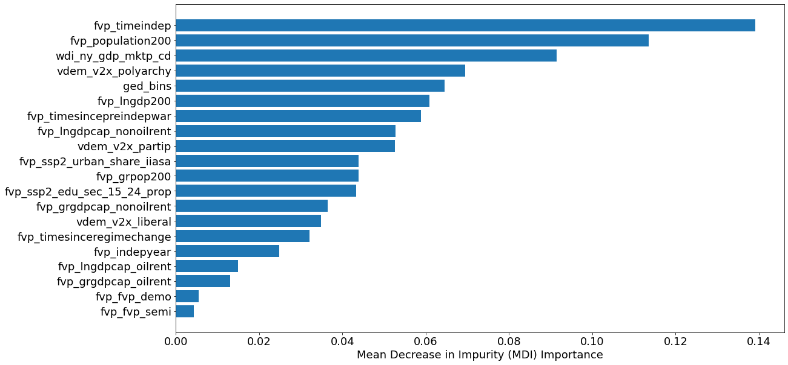
Feature Selection: most original data(not categorized)
Feature selection(predict acled)
Feature importance analysis in Random Forest: Mean Decrease in Impurity (MDI)

Slide 62
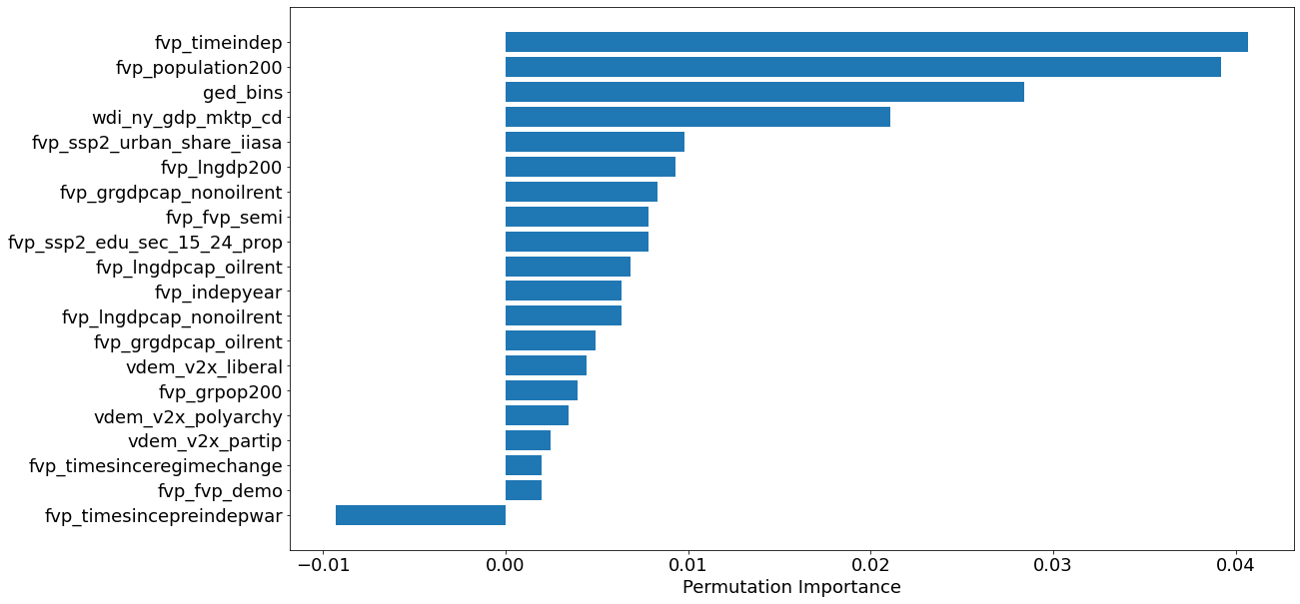
Feature Selection: : most original data(not categorized)
Feature selection (predict acled)
Feature importance analysis in Random Forest: Permutation Importance
Notes:
they are computed as the mean and standard deviation of accumulation of the impurity decrease within each tree.
Impurity-based feature importances can be misleading for high cardinality features (many unique values). See Permutation feature importance as an alternative below.

Slide 63
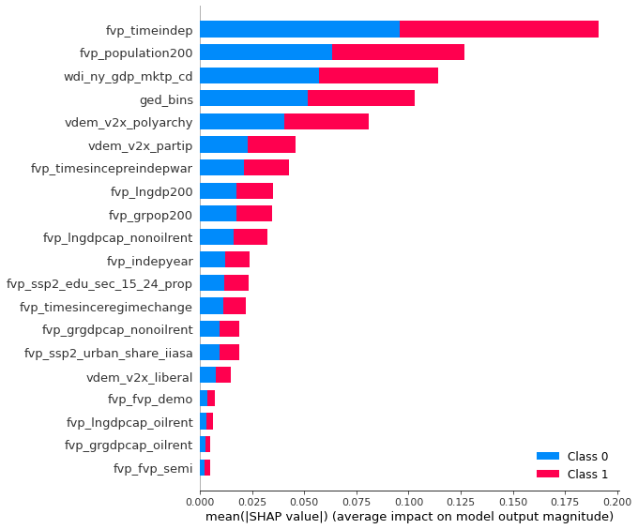
Feature Selection: : most original data(not categorized)
Feature selection: (predict acled)
Feature importance analysis in Random Forest: shap
Notes:
he permutation based importance can be used to overcome drawbacks of default feature importance computed with mean impurity decrease. It is implemented in scikit-learn as permutation_importance method. As arguments it requires trained model (can be any model compatible with scikit-learn API) and validation (test data). This method will randomly shuffle each feature and compute the change in the model’s performance. The features which impact the performance the most are the most important one.
The permutation importance can be easily computed:

Slide 64
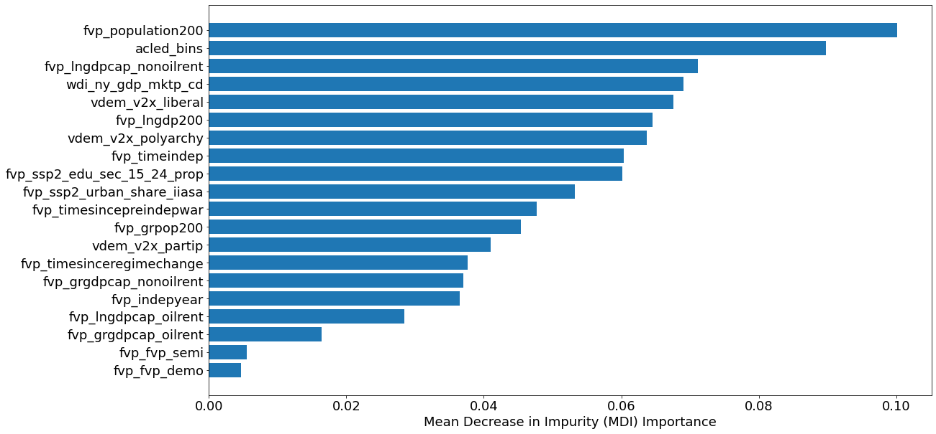
Feature Selection: most original data(not categorized)
Feature selection(predict ged)
Feature importance analysis in Random Forest: Mean Decrease in Impurity (MDI)

Slide 65
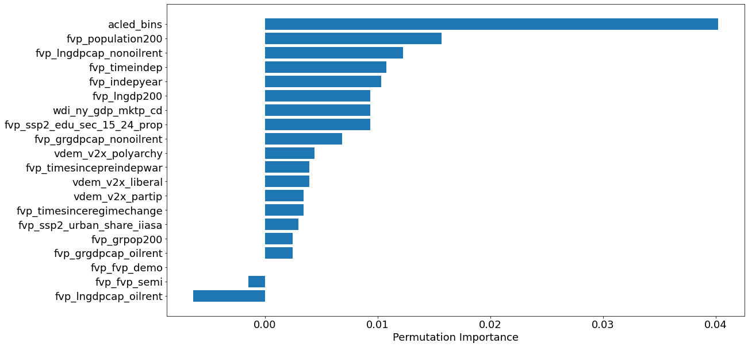
Feature Selection: : most original data(not categorized)
Feature selection (predict ged)
Feature importance analysis in Random Forest: Permutation Importance
Notes:
they are computed as the mean and standard deviation of accumulation of the impurity decrease within each tree.
Impurity-based feature importances can be misleading for high cardinality features (many unique values). See Permutation feature importance as an alternative below.

Slide 66
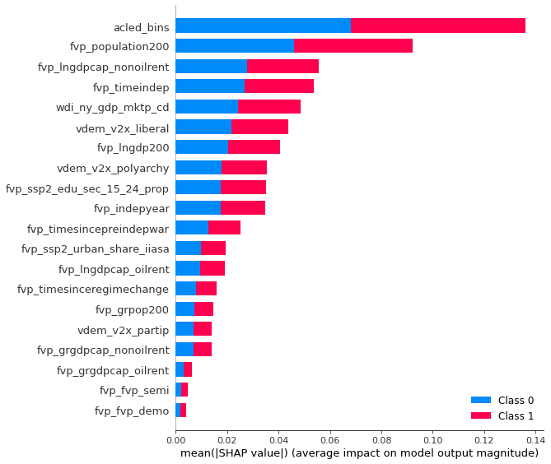
Feature Selection: : most original data(not categorized)
Feature selection: (predict ged)
Feature importance analysis in Random Forest: shap
Notes:
he permutation based importance can be used to overcome drawbacks of default feature importance computed with mean impurity decrease. It is implemented in scikit-learn as permutation_importance method. As arguments it requires trained model (can be any model compatible with scikit-learn API) and validation (test data). This method will randomly shuffle each feature and compute the change in the model’s performance. The features which impact the performance the most are the most important one.
The permutation importance can be easily computed:

Slide 67
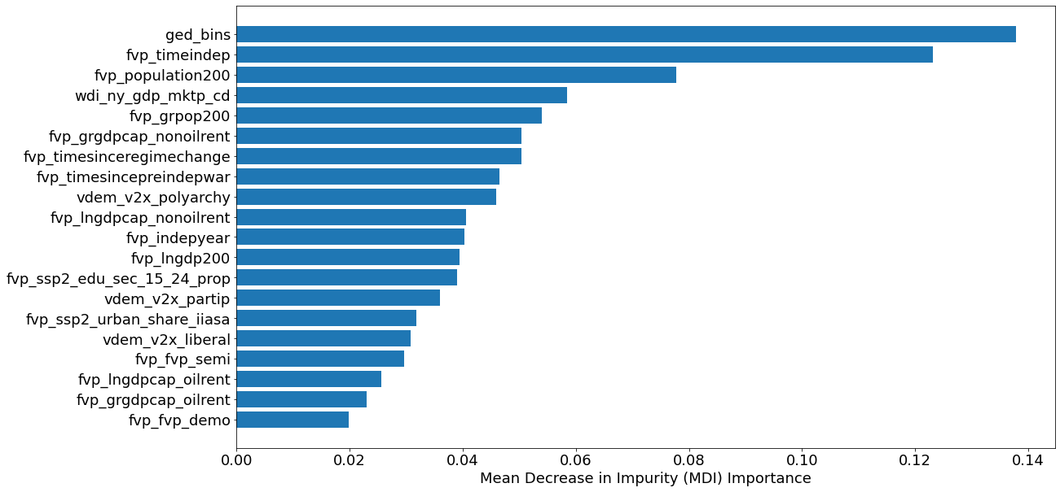
Feature Selection: categorized data
Feature selection: acled
Feature importance analysis in Random Forest: Mean Decrease in Impurity (MDI)

Slide 68
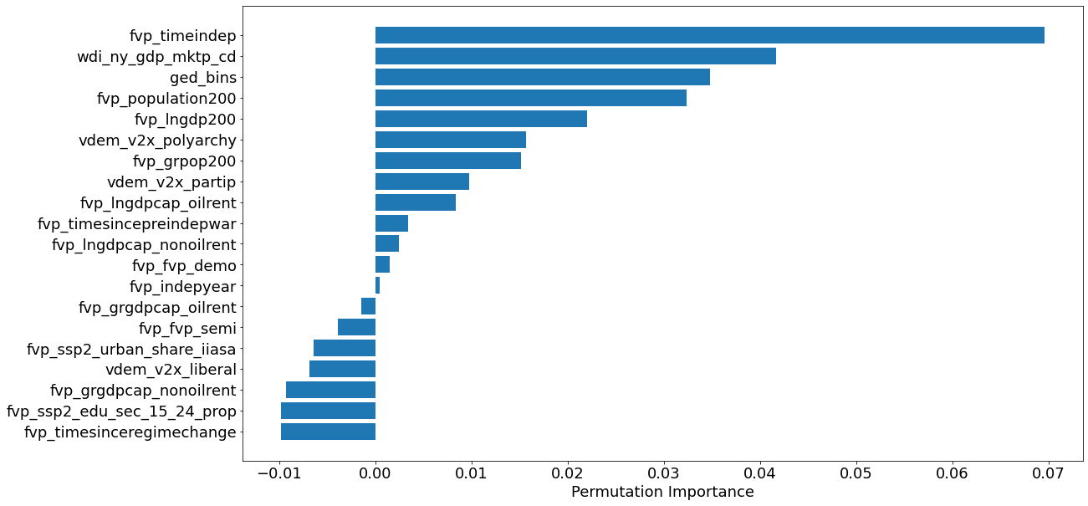
Feature Selection: : categorized data
Feature selection: acled
Feature importance analysis in Random Forest: Permutation Importance
Notes:
they are computed as the mean and standard deviation of accumulation of the impurity decrease within each tree.
Impurity-based feature importances can be misleading for high cardinality features (many unique values). See Permutation feature importance as an alternative below.

Slide 69

Feature Selection: : categorized data
Feature selection: acled
Feature importance analysis in Random Forest: shap
Notes:
he permutation based importance can be used to overcome drawbacks of default feature importance computed with mean impurity decrease. It is implemented in scikit-learn as permutation_importance method. As arguments it requires trained model (can be any model compatible with scikit-learn API) and validation (test data). This method will randomly shuffle each feature and compute the change in the model’s performance. The features which impact the performance the most are the most important one.
The permutation importance can be easily computed:

Slide 70

Feature Selection: categorized data
Feature selection: ged
Feature importance analysis in Random Forest: Mean Decrease in Impurity (MDI)

Slide 71

Feature Selection: : categorized data
Feature selection: ged
Feature importance analysis in Random Forest: Permutation Importance
Notes:
they are computed as the mean and standard deviation of accumulation of the impurity decrease within each tree.
Impurity-based feature importances can be misleading for high cardinality features (many unique values). See Permutation feature importance as an alternative below.

Slide 72

Feature Selection: : categorized data
Feature selection: ged
Feature importance analysis in Random Forest: shap
Notes:
he permutation based importance can be used to overcome drawbacks of default feature importance computed with mean impurity decrease. It is implemented in scikit-learn as permutation_importance method. As arguments it requires trained model (can be any model compatible with scikit-learn API) and validation (test data). This method will randomly shuffle each feature and compute the change in the model’s performance. The features which impact the performance the most are the most important one.
The permutation importance can be easily computed:

Slide 73
Feature Selection: importance summary
Notes:
he permutation based importance can be used to overcome drawbacks of default feature importance computed with mean impurity decrease. It is implemented in scikit-learn as permutation_importance method. As arguments it requires trained model (can be any model compatible with scikit-learn API) and validation (test data). This method will randomly shuffle each feature and compute the change in the model’s performance. The features which impact the performance the most are the most important one.
The permutation importance can be easily computed:

Slide 74
Views: Ged with selected features
features_important = ['wdi_ny_gdp_mktp_cd', 'fvp_population200', 'fvp_timeindep', 'vdem_v2x_polyarchy', 'fvp_lngdpcap_nonoilrent', 'fvp_timesincepreindepwar’, 'acled_bins', 'ged_bins']
bool
Original, bool(acled and ged)
Acled | F1 for set 3 with selected features |  | F1 for set 5 with selected features
Model | Training | Test | Training | Test
LogisticRegression | 0.782 | 0.747 | 0.248 | 0.254
SVC | 0.787 | 0.733 | 0.622 | 0.595
GaussianNB | 0.775 | 0.728 | 0.581 | 0.540
SGDClassifier | 0.780 | 0.750 | 0.248 | 0.254
KNeighborsClassifier | 0.767 | 0.676 | 0.741 | 0.602
DecisionTreeClassifier | 0.796 | 0.738 | 1.000 | 0.812
RandomForestClassifier | 0.801 | 0.723 | 1.000 | 0.824
GradientBoostingClassifier | 0.785 | 0.736 | 0.897 | 0.832
LGBMClassifier | 0.801 | 0.729 | 0.996 | 0.831

Slide 75
Views: Ged with selected features
features_important = ['wdi_ny_gdp_mktp_cd', 'fvp_population200', 'fvp_timeindep', 'vdem_v2x_polyarchy', 'fvp_lngdpcap_nonoilrent', 'fvp_timesincepreindepwar’, 'acled_bins', 'ged_bins']
bool
Original, bool(acled and ged)
Ged | F1 for set 3 with selected features |  | F1 for set 5 with selected features
Model | Training | Test | Training | Test
LogisticRegression | 0.678 | 0.641 | 0.447948 | 0.447154
SVC | 0.758 | 0.690 | 0.509205 | 0.483621
GaussianNB | 0.695 | 0.652 | 0.547833 | 0.561246
SGDClassifier | 0.496 | 0.508 | 0.447948 | 0.447154
KNeighborsClassifier | 0.763 | 0.691 | 0.67359 | 0.518212
DecisionTreeClassifier | 0.763 | 0.702 | 1 | 0.774351
RandomForestClassifier | 0.765 | 0.702 | 0.998995 | 0.810163
GradientBoostingClassifier | 0.735 | 0.700 | 0.895551 | 0.75858
LGBMClassifier | 0.763 | 0.702 | 1 | 0.796906

Slide 76
Views: Ged with selected features
features_important = ['wdi_ny_gdp_mktp_cd', 'fvp_population200', 'fvp_timeindep', 'vdem_v2x_polyarchy', 'fvp_lngdpcap_nonoilrent', 'fvp_timesincepreindepwar’, 'acled_bins', 'ged_bins']
Test Different Random States for train test split
Acled (set 3 with selected features) | F1 with rs = 1 |  | F1 with rs = 2 |  |  | F1 with rs = 3 |  | F1 with rs = 4 |  | F1 with rs = 5
Model | Training | Test | Training | Test | Test | Training | Test | Training | Test | Training | Test
LogisticRegression | 0.791 | 0.739 | 0.777 | 0.799 | 0.799 | 0.783 | 0.744 | 0.791 | 0.731 | 0.782 | 0.747
SVC | 0.797 | 0.740 | 0.792 | 0.774 | 0.774 | 0.797 | 0.744 | 0.811 | 0.726 | 0.787 | 0.733
GaussianNB | 0.776 | 0.720 | 0.759 | 0.779 | 0.779 | 0.767 | 0.754 | 0.780 | 0.708 | 0.775 | 0.728
SGDClassifier | 0.701 | 0.668 | 0.755 | 0.768 | 0.768 | 0.778 | 0.735 | 0.699 | 0.645 | 0.780 | 0.750
KNeighborsClassifier | 0.797 | 0.745 | 0.772 | 0.781 | 0.781 | 0.728 | 0.726 | 0.808 | 0.720 | 0.767 | 0.676
DecisionTreeClassifier | 0.803 | 0.742 | 0.795 | 0.775 | 0.775 | 0.802 | 0.732 | 0.805 | 0.721 | 0.796 | 0.738
RandomForestClassifier | 0.804 | 0.739 | 0.798 | 0.785 | 0.785 | 0.802 | 0.732 | 0.809 | 0.718 | 0.801 | 0.723
GradientBoostingClassifier | 0.794 | 0.735 | 0.785 | 0.804 | 0.804 | 0.787 | 0.744 | 0.809 | 0.716 | 0.785 | 0.736
LGBMClassifier | 0.806 | 0.745 | 0.797 | 0.784 | 0.784 | 0.803 | 0.738 | 0.805 | 0.716 | 0.801 | 0.729

Slide 77

Views: Ged with selected features
features_important = ['wdi_ny_gdp_mktp_cd', 'fvp_population200', 'fvp_timeindep', 'vdem_v2x_polyarchy', 'fvp_lngdpcap_nonoilrent', 'fvp_timesincepreindepwar’, 'acled_bins', 'ged_bins']
Test Different Random States for train test split

Slide 78








Views: Ged with selected features
features_important = ['wdi_ny_gdp_mktp_cd', 'fvp_population200', 'fvp_timeindep', 'vdem_v2x_polyarchy', 'fvp_lngdpcap_nonoilrent', 'fvp_timesincepreindepwar’, 'acled_bins', 'ged_bins’]
Boolean method:
Percentile: 75%
Acled_bins, ged_bins: 0 or >0

Slide 79






Views: Ged with selected features
features_important = ['wdi_ny_gdp_mktp_cd', 'fvp_population200', 'fvp_timeindep', 'vdem_v2x_polyarchy', 'fvp_lngdpcap_nonoilrent', 'fvp_timesincepreindepwar’, 'acled_bins', 'ged_bins’]
Boolean method:
Percentile: 60%
Acled_bins, ged_bins: 0 or >0

Slide 80
Views: Acled with selected features
Model | F1 Score
Model | P=50% | P=60% | P=75%
LogisticRegression | 0.747 | 0.719 | 0.670
SVC | 0.733 | 0.768 | 0.715
GaussianNB | 0.728 | 0.725 | 0.714
SGDClassifier | 0.750 | 0.622 | 0.685
KNeighborsClassifier | 0.676 | 0.753 | 0.702
DecisionTreeClassifier | 0.738 | 0.766 | 0.717
RandomForestClassifier | 0.723 | 0.766 | 0.724
GradientBoostingClassifier | 0.736 | 0.783 | 0.678
LGBMClassifier | 0.729 | 0.766 | 0.674
For TM (with the code I have and parameter I set), F1 score is about 0.41, and all predicted output are 0.
Then I delete 500 rows which output = 0 to do kind of balance, the F1 score is 0.15 as all predicted output are 0

Slide 81
Views: acled
Remove records when acled_violence_count = 0,
# 2036 records --> 677 records
then try:
1. regression with all variables (without country_name, contry_id, month_id)
2. classification using original acled_violence_count with all variables
3. regression with selected variables
4. classification with selected variables

Slide 82
Views: acled
Result 1:regression with all variables (without country_name, contry_id, month_id)
two different random setting (5 and 1), test_size = 0.2,
Model | RMSE_Training | R2_Training | RMSE_Test | R2_Test
LinearRegression | 26.06742979 | 0.596075043 | 30.65942135 | 0.50709
RandomForestRegressor | 9.209610126 | 0.949581868 | 27.56889829 | 0.601454
LGBMRegressor | 11.09717903 | 0.926796904 | 28.58700001 | 0.571474
XGBRegressor | 0.337141914 | 0.999932434 | 27.84303425 | 0.593489
CatBoostRegressor | 3.978254929 | 0.99059217 | 27.3665088 | 0.607284
SGDRegressor | 2.12E+31 | -2.66E+59 | 1.90E+31 | ########
KernelRidge | 39.71749285 | 0.062291366 | 40.56853658 | 0.136985
GradientBoostingRegressor | 8.597129428 | 0.956064943 | 28.7719838 | 0.565911
MLPRegressor | 167.6622245 | -15.70993308 | 168.9753383 | -13.9722
Model | RMSE_Training | R2_Training | RMSE_Test | R2_Test
LinearRegression | 27.4460106 | 0.570377437 | 25.03268503 | 0.613329303
RandomForestRegressor | 9.195830587 | 0.951770745 | 21.83818977 | 0.705720735
LGBMRegressor | 11.63262975 | 0.922823614 | 21.37076616 | 0.718183397
XGBRegressor | 0.25887476 | 0.999961778 | 23.50186058 | 0.659175441
CatBoostRegressor | 3.838646168 | 0.991596024 | 21.30640841 | 0.719878215
SGDRegressor | 8.79E+30 | -4.41E+58 | 8.39E+30 | -4.34E+58
KernelRidge | 39.75635365 | 0.098549844 | 40.56633715 | -0.015448687
GradientBoostingRegressor | 8.238684041 | 0.961288115 | 21.39891968 | 0.717440386
MLPRegressor | 38662.55008 | -852528.899 | 36885.04913 | -839511.4158

Slide 83
Views: acled
Result 1:regression with all variables (without country_name, contry_id, month_id)
two different random setting (5 and 1), test_size = 0.4
Model | RMSE_Training | R2_Training | RMSE_Test | R2_Test
LinearRegression | 25.55347085 | 0.585049377 | 29.86396484 | 0.543857555
RandomForestRegressor | 9.305111234 | 0.94497757 | 26.45007898 | 0.642184211
LGBMRegressor | 12.52171893 | 0.900362108 | 26.03268127 | 0.653388189
XGBRegressor | 0.104681979 | 0.999993036 | 25.58875562 | 0.665108682
CatBoostRegressor | 3.493438669 | 0.992244624 | 25.03094869 | 0.679550075
SGDRegressor | 2.41E+31 | -3.68E+59 | 2.36E+31 | -2.85E+59
KernelRidge | 37.30249973 | 0.115755233 | 42.49750128 | 0.076297018
GradientBoostingRegressor | 7.566402444 | 0.963618927 | 25.99315454 | 0.654439947
MLPRegressor | 358065.1049 | -81474296.5 | 350993.9397 | -63009318.7
Model | RMSE_Training | R2_Training | RMSE_Test | R2_Test
LinearRegression | 29.47391162 | 0.540560339 | 23.8923648 | 0.613202007
RandomForestRegressor | 10.19492149 | 0.945030638 | 19.04959375 | 0.754111977
LGBMRegressor | 13.57670698 | 0.902514097 | 19.9956468 | 0.72908263
XGBRegressor | 0.075281414 | 0.999997003 | 22.14007381 | 0.667857793
CatBoostRegressor | 3.220891234 | 0.994513378 | 18.82141925 | 0.759967153
SGDRegressor | 5.01E+30 | -1.33E+58 | 4.93E+30 | -1.65E+58
KernelRidge | 42.17655534 | 0.059204691 | 37.09808147 | 0.067457059
GradientBoostingRegressor | 7.620109756 | 0.969290314 | 18.60108634 | 0.765554147
MLPRegressor | 384373.2324 | -78137443.04 | 378297.8447 | -96969167.54

Slide 84
Views: acled
Result 1:regression with all variables (without country_name, contry_id, month_id)
two different random setting (5 and 1), test_size = 0.6
Model | RMSE_Training | R2_Training | RMSE_Test | R2_Test
LinearRegression | 25.32234137 | 0.613161426 | 29.1601551 | 0.520725
RandomForestRegressor | 9.20486017 | 0.948884049 | 27.889282 | 0.56159
LGBMRegressor | 12.22507114 | 0.909837728 | 29.1337512 | 0.521592
XGBRegressor | 0.038342752 | 0.999999113 | 29.0952075 | 0.522857
CatBoostRegressor | 1.55663291 | 0.998538178 | 25.7358794 | 0.626678
SGDRegressor | 1.31E+29 | -1.04E+55 | 1.22E+29 | ########
KernelRidge | 38.37843747 | 0.111419797 | 40.5427507 | 0.073529
GradientBoostingRegressor | 5.27059935 | 0.983241233 | 27.8032873 | 0.56429
MLPRegressor | 165531.7506 | -16530448.82 | 153435.605 | -1.3E+07
Model | RMSE_Training | R2_Training | RMSE_Test | R2_Test
LinearRegression | 27.39845312 | 0.535255124 | 29.517294 | 0.516581
RandomForestRegressor | 10.81558712 | 0.927579299 | 30.342394 | 0.489177
LGBMRegressor | 13.68148219 | 0.884114574 | 27.430618 | 0.582514
XGBRegressor | 0.052723266 | 0.999998279 | 34.056608 | 0.356463
CatBoostRegressor | 2.563672708 | 0.995931 | 29.17129 | 0.527848
SGDRegressor | 7.66E+30 | -3.63E+58 | 7.45E+30 | ########
KernelRidge | 40.77258896 | -0.02919839 | 42.935473 | -0.02283
GradientBoostingRegressor | 5.973317625 | 0.977910101 | 30.445594 | 0.485696
MLPRegressor | 30955959 | -5.9327E+11 | 30139840 | -5E+11

Slide 85
Views: acled
Result 2:classification using original acled_violence_count with all variables
two different random setting (5 and 1), test_size = 0.2
Model | F1_Score_Training | F1_Score_Test
LogisticRegression | 0.003151641 | 0.006875139
SVC | 0.014858768 | 0.007122507
GaussianNB | 0.488666766 | 0.008222812
SGDClassifier | 7.44E-05 | 0
KNeighborsClassifier | 0.039932389 | 0.009026928
DecisionTreeClassifier | 1 | 0.012425075
RandomForestClassifier | 1 | 0.018383361
GradientBoostingClassifier | 1 | 0.012888494
LGBMClassifier | 1 | 0.01854537
Model | F1_Score_Training | F1_Score_Test
LogisticRegression | 0.003091 | 0.007222
SVC | 0.013702 | 0.007678
GaussianNB | 0.490868 | 0.00882
SGDClassifier | 3.48E-05 | 0
KNeighborsClassifier | 0.049785 | 0.019099
DecisionTreeClassifier | 1 | 0.016426
RandomForestClassifier | 1 | 0.023244
GradientBoostingClassifier | 1 | 0.012359
LGBMClassifier | 1 | 0.031764

Slide 86
Views: acled
Result 2:classification using original acled_violence_count with all variables
two different random setting (5 and 1), test_size = 0.4
Model | F1_Score_Training | F1_Score_Test
LogisticRegression | 0.003462704 | 0.004584305
SVC | 0.023774197 | 0.00696136
GaussianNB | 0.572694365 | 0.005969232
SGDClassifier | 0.002293753 | 0.002478632
KNeighborsClassifier | 0.041361393 | 0.008200335
DecisionTreeClassifier | 1 | 0.028146518
RandomForestClassifier | 1 | 0.016128338
GradientBoostingClassifier | 1 | 0.010284987
LGBMClassifier | 1 | 0.012982805
Model | F1_Score_Training | F1_Score_Test
LogisticRegression | 0.003465454 | 0.005028098
SVC | 0.010953024 | 0.005191368
GaussianNB | 0.523340335 | 0.006244906
SGDClassifier | 0.000893744 | 0.00091028
KNeighborsClassifier | 0.039845338 | 0.008682036
DecisionTreeClassifier | 1 | 0.018056558
RandomForestClassifier | 1 | 0.011747199
GradientBoostingClassifier | 1 | 0.010353954
LGBMClassifier | 1 | 0.03302076

Slide 87
Views: acled
Result 3: regression with selected variables
two different random setting (5 and 1), test_size = 0.2
Model | RMSE_Training | R2_Training | RMSE_Test | R2_Test
LinearRegression | 27.95982897 | 0.53529935 | 33.62287151 | 0.40719867
RandomForestRegressor | 9.069753465 | 0.95110153 | 27.26625907 | 0.610156155
LGBMRegressor | 13.2732091 | 0.89527361 | 27.27819681 | 0.609814717
XGBRegressor | 0.475661516 | 0.99986551 | 28.10374611 | 0.58584015
CatBoostRegressor | 5.229725155 | 0.98374219 | 25.99093398 | 0.645771631
SGDRegressor | 1.05E+31 | -6.56E+58 | 9.43E+30 | -4.66E+58
KernelRidge | 39.91972948 | 0.05271766 | 42.79751412 | 0.03954581
GradientBoostingRegressor | 10.51073146 | 0.93432953 | 28.10520253 | 0.585797223
MLPRegressor | 377220.4197 | -84585252 | 338561.9922 | -60105742.08
Model | RMSE_Training | R2_Training | RMSE_Test | R2_Test
LinearRegression | 29.99467565 | 0.486882333 | 25.49635481 | 0.598872
RandomForestRegressor | 9.848103855 | 0.944686153 | 23.38015431 | 0.662696
LGBMRegressor | 13.76682557 | 0.891907329 | 22.05502979 | 0.699848
XGBRegressor | 0.395654315 | 0.999910719 | 24.79954853 | 0.620498
CatBoostRegressor | 5.111057 | 0.985101242 | 21.29989695 | 0.720049
SGDRegressor | 2.54E+31 | -3.67E+59 | 2.42E+31 | ########
KernelRidge | 39.33032883 | 0.117766016 | 39.24959824 | 0.049402
GradientBoostingRegressor | 9.625792308 | 0.94715528 | 22.66815548 | 0.682927
MLPRegressor | 424321413.7 | -1.02688E+14 | 404880560.8 | -1E+14

Slide 88
Views: acled
Result 3: regression with selected variables
two different random setting ( 1), test_size = 0.1
Model | RMSE_Training | R2_Training | RMSE_Test | R2_Test
LinearRegression | 29.47294965 | 0.49991035 | 25.9896896 | 0.586496
RandomForestRegressor | 9.74907522 | 0.94528234 | 16.8093581 | 0.827027
LGBMRegressor | 13.82190785 | 0.89001419 | 16.6580133 | 0.830127
XGBRegressor | 0.516961337 | 0.99984614 | 17.0954648 | 0.821088
CatBoostRegressor | 5.372043309 | 0.98338579 | 15.1023711 | 0.860374
SGDRegressor | 3.93E+30 | -8.89E+57 | 2.64E+30 | ########
KernelRidge | 39.45998589 | 0.10357386 | 43.7264082 | -0.17048
GradientBoostingRegressor | 11.33497222 | 0.92603239 | 13.7650177 | 0.884007
MLPRegressor | 1089349.611 | -683180126 | 732763.046 | -3.3E+08

Slide 89

Views: acled_count_violence histogram for next step categories

Slide 90


Slide 91







1
2
3
Somalia
Somali Democratic Republic (1969–1991)
Somalia Civil War (1991 - 2006)
Somalia War (2006–2009)
Somali Civil War (2009–present)
(From wiki)
4
5
6
7

Slide 92
1
3
Event label generating: threshold
Somalia
Somali Democratic Republic (1969–1991)
Somalia Civil War (1991 - 2006)
Somalia War (2006–2009)
Somali Civil War (2009–present)
(From wiki)
4
Change point in the feature (may consider multiple features with close change point)

Slide 93





Rwandan genocide
Rwandan genocide (1994)

Slide 94

Frame work: simulation

Slide 95



Frame work
Framework
Difference_socre

Slide 96

Frame work
Framework
Difference_socre_v2

Slide 97


Frame work
Framework
Difference_socre

Slide 98

Frame work
Framework
Difference_socre_v2

Slide 99

Frame work: next step
Scoring function:
Difference score: v1
Difference score: v2
RMSE
Notes:
V1:
score_p = sum_li(distance_li_p) + p_f_p + p_l_p
score_r = sum_li(distance_li_r) + p_f_r + p_l_r
V2:
portion_paired_points_p = (num_pair_p*2)/num_total
portion_paired_points_r = (num_pair_r*2)/num_total
score_p = sum_li(distance_li_p)/num_pair_p*portion_paired_points_p + (p_f_p + p_l_p)*(1 - portion_paired_points_p)
score_r = sum_li(distance_li_r)/num_pair_r*portion_paired_points_r + (p_f_r + p_l_r)*(1 - portion_paired_points_r)

Slide 100


Label: cos
Feature: sin

Slide 101


id of the min_score: 80
id of min threshold for label: 8
and threold value is: 9
id of min threshold for feature: 8
and threold value is: 9
Training
Score function: v2
id of the min_score: 80
id of min threshold for label: 8
and threold value is: 9
id of min threshold for feature: 8
and threold value is: 9
Test

Slide 102

Accuracy of different score system: no shift considered
(1,1)
Cos/Sin may not be a good sample
Shift should be considered
Accuracy
label
feature
(9,9)

Slide 103

Accuracy of different score system: no shift considered
Cos/Sin may not be a good sample
Shift should be considered
Accuracy
label
feature

Slide 104

Label: cos
p_lwf = p_fl / p_f
Feature: cos

Slide 105

Label: cos
p_lwf = p_fl / p_f
Feature: sin

Slide 106


Label:
random seeds:2
p_lwf = p_fl / p_f
Feature:
Random seeds: 1

Slide 107


Label:
random seeds:999
p_lwf = p_fl / p_f
Feature:
Random seeds: 3

Slide 108
Entropy
Entropy Cos/Sin Cos/Cos rand/rand rand/rand
Method1 4.196607702 2.27963666 3.225641054 3.380532525
Method2 17.99444812 0.741708747 9.255748287 10.64977153
Method3 2.197224577 2.197224577 2.197224577 1.831020481
Method4 4.196607702 2.27963666 3.225641054 3.380532525

Slide 109



Bool Data warehouse Framework

Slide 110
1
2
3
Somalia
Somali Democratic Republic (1969–1991)
Somalia Civil War (1991 - 2006)
Somalia War (2006–2009)
Somali Civil War (2009–present)
(From wiki)
4
5
6
7

Slide 111








Conditional Probability Map (original data)
fvp_lngdpcap_nonoilrent
feature: wdi_ny_gdp_mktp_cd
fvp_population200
fvp_lngdp200
vdem_v2x_polyarchy
acled_count_sb
vdem_v2x_partip
vdem_v2x_liberal
For certain features, may not using the original data,
Deviation or |deviation|
Opposite direction to set up threshold.

Slide 112

Find the best threshold

Slide 113






Different resolution
f_name_li = ['wdi_ny_gdp_mktp_cd'] l_name = 'acled_count_violence' num_of_threshold_li = [2, 4, 10, 20, 50, 100]
resolution | l_thr_id | f_thr_id | CP value | resolution | a | accuracy
2 | 0 | 0 | 0 | 2 | 0.9 | 1
4 | 2 | 2 | 1 | 4 | 0.9 | 0.975
10 | 5 | 6 | 1 | 10 | 0.9 | 0.925
20 | 10 | 11 | 0.9 | 20 | 0.9 | 0.975
50 | 25 | 28 | 0.9 | 50 | 0.9 | 0.975
100 | 50 | 57 | 0.9 | 100 | 0.9 | 0.975

Slide 114

Different resolution: entropy
resolution | 2 | 4 | 10 | 20 | 50 | 100
entropy 0 | 0.375 | 1.144 | 2.133 | 2.836 | 3.79 | 4.492
entropy 1 | 1.039 | 1.646 | 3.104 | 3.567 | 4.145 | 4.2608
entropy 2 | 0.693 | 1.039 | 8.02 | 11.42 | 11.67 | -34.43
entropy 3 | 0.693 | 1.386 | 2.163 | 2.458 | 2.47 | 2.4953
entropy 4 | 1.039 | 1.646 | 3.104 | 3.567 | 4.145 | 4.2608
Notes:
D:\jiawei\research\Research\PULSAR\vladimir\change_point\entropy.xlsx

Slide 115

Different resolution: Variance
resolution | 2 | 4 | 10 | 20 | 50 | 100
variance | 0.16418 | 0.15473 | 0.123805 | 0.122273 | 0.111561 | 0.109837
Notes:
D:\jiawei\research\Research\PULSAR\vladimir\change_point\entropy.xlsx

Slide 116


Different resolution: entropy
resolution | 2 | 4 | 10 | 20 | 50 | 100
best thr for label | 0 | 162.66 | 135.55 | 128.42 | 124.48 | 123.23
best thr for feature | 6.04E+08 | 3.35E+09 | 3.35E+09 | 2.99E+09 | 2.96E+09 | 2.97E+09
Notes:
D:\jiawei\research\Research\PULSAR\vladimir\change_point\entropy.xlsx

Slide 117
Conditional Probability Map (original data)
fvp_lngdpcap_nonoilrent
feature: wdi_ny_gdp_mktp_cd
fvp_population200
fvp_lngdp200
features | l_thr_id | f_thr_id | CP value | resolution | a
'wdi_ny_gdp_mktp_cd', | 25 | 28 | 0.9 | 50 | 0.9
'fvp_lngdp200', | 15 | 44 | 1 | 50 | 0.9
'fvp_lngdpcap_nonoilrent', | 0 | 0 | 1 | 50 | 0.9
'fvp_population200', | 25 | 32 | 0.9 | 50 | 0.9
'vdem_v2x_polyarchy', | 25 | 45 | 1 | 50 | 0.9
'vdem_v2x_liberal', | 25 | 40 | 1 | 50 | 0.9
vdem_v2x_partip | 25 | 36 | 1 | 50 | 0.9
acled_count_sb | 25 | 25 | 1 | 50 | 0.9
vdem_v2x_partip
vdem_v2x_polyarchy
acled_count_sb
vdem_v2x_liberal
Notes:
[l, f] = [25,28] v= 0.9
D:\jiawei\research\Research\PULSAR\vladimir\change_point\entropy.xlsx

Slide 118



Conditional Probability Map (original data)
Somalia
All countries
features | l_thr_id | f_thr_id | value | total_thr | a | accuracy
'wdi_ny_gdp_mktp_cd', | 25 | 28 | 0.9 | 50 | 0.9 | 0.975
'fvp_lngdp200', | 15 | 44 | 1 | 50 | 0.9 | 0.775
'fvp_lngdpcap_nonoilrent', | 0 | 0 | 1 | 50 | 0.9 | 1
'fvp_population200', | 25 | 32 | 0.9 | 50 | 0.9 | 0.975
'vdem_v2x_polyarchy', | 25 | 45 | 1 | 50 | 0.9 | 0.8
'vdem_v2x_liberal', | 25 | 40 | 1 | 50 | 0.9 | 0.9
vdem_v2x_partip | 25 | 36 | 1 | 50 | 0.9 | 0.925
acled_count_sb | 25 | 25 | 1 | 50 | 0.9 | 0.95
l_name = 'acled_count_violence'
Notes:
D:\jiawei\research\Research\PULSAR\vladimir\change_point\entropy.xlsx

Slide 119
Conditional Probability Map (original data)
best thr for l:
[124.48979591836735, 74.6938775510204, 0.0, 124.48979591836735, 124.48979591836735, 124.48979591836735, 124.48979591836735, 124.48979591836735]
best thr for f:
[2956397000.0, 9.459304081632654, 6.187469999999999, 9.314320612244899, 0.20520408163265308, 0.3803877551020408, 0.33685714285714285, 54.59183673469388]
Notes:
D:\jiawei\research\Research\PULSAR\vladimir\change_point\entropy.xlsx

Slide 120





Conditional Probability Map (original data)
entropy | 'wdi_ny_gdp_mktp_cd', | 'fvp_lngdp200', | 'fvp_lngdpcap_nonoilrent', | 'fvp_population200', | 'vdem_v2x_polyarchy', | 'vdem_v2x_liberal', | vdem_v2x_partip | acled_count_sb
0 | 3.790827 | 3.009777 | 2.309797 | 3.77934 | 3.47098 | 3.756973 | 3.741201 | 3.835826
1 | 4.260817 | 4.145511 | 3.304828 | 2.087109 | 4.294033 | 3.86756 | 3.743796 | 3.432271
2 | -34.4353 | 11.67442 | -30.3598 | -91.2457 | 19.10048 | -2.22314 | -8.41134 | -23.9876
3 | 2.49533 | 2.470635 | 2.470635 | 2.470635 | 2.470635 | 2.470635 | 2.470635 | 2.470635
4 | 4.260817 | 4.145511 | 3.304828 | 2.087109 | 4.294033 | 3.86756 | 3.743796 | 3.432271
Notes:
D:\jiawei\research\Research\PULSAR\vladimir\change_point\entropy.xlsx

Slide 121

Conditional Probability Map (original data)
entropy | 'wdi_ny_gdp_mktp_cd', | 'fvp_lngdp200', | 'fvp_lngdpcap_nonoilrent', | 'fvp_population200', | 'vdem_v2x_polyarchy', | 'vdem_v2x_liberal', | vdem_v2x_partip | acled_count_sb
0 | 3.790827 | 3.009777 | 2.309797 | 3.77934 | 3.47098 | 3.756973 | 3.741201 | 3.835826
1 | 4.260817 | 4.145511 | 3.304828 | 2.087109 | 4.294033 | 3.86756 | 3.743796 | 3.432271
2 | -34.4353 | 11.67442 | -30.3598 | -91.2457 | 19.10048 | -2.22314 | -8.41134 | -23.9876
3 | 2.49533 | 2.470635 | 2.470635 | 2.470635 | 2.470635 | 2.470635 | 2.470635 | 2.470635
4 | 4.260817 | 4.145511 | 3.304828 | 2.087109 | 4.294033 | 3.86756 | 3.743796 | 3.432271
Notes:
D:\jiawei\research\Research\PULSAR\vladimir\change_point\entropy.xlsx

Slide 122

Conditional Probability Map (original data)
Notes:
D:\jiawei\research\Research\PULSAR\vladimir\change_point\entropy.xlsx
Entropy 0 lower -→ difference between cp acc and mean acc higher

Slide 123

Conditional Probability Map (original data)
Different Measurement: Variance
Notes:
D:\jiawei\research\Research\PULSAR\vladimir\change_point\entropy.xlsx
Entropy 0 lower -→ difference between cp acc and mean acc higher

Slide 124

Conditional Probability Map (original data)
Different Measurement: Variance
Notes:
D:\jiawei\research\Research\PULSAR\vladimir\change_point\entropy.xlsx
Entropy 0 lower -→ difference between cp acc and mean acc higher

Slide 125
Conditional Probability Map (original data)
Different Measurement: Entropy0 VS Variance
Notes:
D:\jiawei\research\Research\PULSAR\vladimir\change_point\entropy.xlsx
Entropy 0 lower -→ difference between cp acc and mean acc higher

Slide 126






Conditional Probability Map (annual difference)
features
'wdi_ny_gdp_mktp_cd',
'fvp_lngdp200',
'fvp_lngdpcap_nonoilrent',
'fvp_population200',
'vdem_v2x_polyarchy',
'vdem_v2x_liberal',
vdem_v2x_partip
acled_count_sb
Notes:
D:\jiawei\research\Research\PULSAR\vladimir\change_point\entropy.xlsx
Entropy 0 lower -→ difference between cp acc and mean acc higher

Slide 127






Conditional Probability Map (annual difference)
Notes:
D:\jiawei\research\Research\PULSAR\vladimir\change_point\entropy.xlsx
Entropy 0 lower -→ difference between cp acc and mean acc higher

Slide 128

Conditional Probability Map (annual difference)
Different data sets: original VS annual difference
Notes:
D:\jiawei\research\Research\PULSAR\vladimir\change_point\entropy.xlsx
Entropy 0 lower -→ difference between cp acc and mean acc higher

Slide 129









Conditional Probability Map: Ethiopia
features
'wdi_ny_gdp_mktp_cd',
'fvp_lngdp200',
'fvp_lngdpcap_nonoilrent',
'fvp_population200',
'vdem_v2x_polyarchy',
'vdem_v2x_liberal',
vdem_v2x_partip
acled_count_sb
Notes:
D:\jiawei\research\Research\PULSAR\vladimir\change_point\entropy.xlsx
Entropy 0 lower -→ difference between cp acc and mean acc higher

Slide 130








Conditional Probability Map: Ethiopia
features | l_thr_id | f_thr_id | total_thr | a | accuracy | variance | entropy
'wdi_ny_gdp_mktp_cd', | 8 | 37 | 50 | 0.9 | 0.96 | 0.07 | 3.56
'fvp_lngdp200', | 1 | 28 | 50 | 0.9 | 0.7 | 0.06 | 3.46
'fvp_lngdpcap_nonoilrent', | 1 | 25 | 50 | 0.9 | 0.7 | 0.05 | 3.52
'fvp_population200', | 8 | 42 | 50 | 0.9 | 0.96 | 0.06 | 3.36
'vdem_v2x_polyarchy', | 8 | 39 | 50 | 0.9 | 0.89 | 0.07 | 3.06
'vdem_v2x_liberal', | 8 | 39 | 50 | 0.9 | 0.89 | 0.07 | 2.93
vdem_v2x_partip | 1 | 33 | 50 | 0.9 | 0.48 | 0.04 | 1.74
acled_count_sb | 7 | 33 | 50 | 0.9 | 0.81 | 0.084 | 3.49
features | l_thr_id | f_thr_id | CP value | resolution | a
'wdi_ny_gdp_mktp_cd', | 25 | 28 | 0.9 | 50 | 0.9
'fvp_lngdp200', | 15 | 44 | 1 | 50 | 0.9
'fvp_lngdpcap_nonoilrent', | 0 | 0 | 1 | 50 | 0.9
'fvp_population200', | 25 | 32 | 0.9 | 50 | 0.9
'vdem_v2x_polyarchy', | 25 | 45 | 1 | 50 | 0.9
'vdem_v2x_liberal', | 25 | 40 | 1 | 50 | 0.9
vdem_v2x_partip | 25 | 36 | 1 | 50 | 0.9
acled_count_sb | 25 | 25 | 1 | 50 | 0.9
Notes:
D:\jiawei\research\Research\PULSAR\vladimir\change_point\entropy.xlsx
Entropy 0 lower -→ difference between cp acc and mean acc higher

Slide 131



Conditional Probability Map: Ethiopia
best thr for l:
[19.918367346938776, 2.489795918367347, 2.489795918367347, 19.918367346938776, 19.918367346938776, 19.918367346938776, 2.489795918367347, 17.42857142857143]
best thr for f:
[65393651020.40816, 11.372328571428572, 6.916226734693877, 94.07912857142858, 0.26924489795918366, 0.33155102040816326, 0.21948979591836734, 8.081632653061224]
Notes:
D:\jiawei\research\Research\PULSAR\vladimir\change_point\entropy.xlsx
Entropy 0 lower -→ difference between cp acc and mean acc higher

Slide 132









Conditional Probability Map: Uganda
features
'wdi_ny_gdp_mktp_cd',
'fvp_lngdp200',
'fvp_lngdpcap_nonoilrent',
'fvp_population200',
'vdem_v2x_polyarchy',
'vdem_v2x_liberal',
vdem_v2x_partip
acled_count_sb
Notes:
D:\jiawei\research\Research\PULSAR\vladimir\change_point\entropy.xlsx
Entropy 0 lower -→ difference between cp acc and mean acc higher

Slide 133








Conditional Probability Map: Uganda
features | l_thr_id | f_thr_id | resolution | a | accuracy | variance | entropy
'wdi_ny_gdp_mktp_cd', | 2 | 25 | 50 | 0.9 | 0.725 | 0.79 | 2.85
'fvp_lngdp200', | 2 | 25 | 50 | 0.9 | 0.85 | 0.08 | 3.11
'fvp_lngdpcap_nonoilrent', | 2 | 25 | 50 | 0.9 | 0.825 | 0.08 | 3.08
'fvp_population200', | 3 | 31 | 50 | 0.9 | 0.7 | 0.08 | 3.01
'vdem_v2x_polyarchy', | 2 | 41 | 50 | 0.9 | 0.725 | 0.06 | 3.28
'vdem_v2x_liberal', | 15 | 48 | 50 | 0.9 | 0.85 | 0.06 | 3.31
vdem_v2x_partip | 2 | 25 | 50 | 0.9 | 0.95 | 0.07 | 3.36
acled_count_sb | 25 | 25 | 50 | 0.9 | 1 | 0.1 | 3.81
Notes:
D:\jiawei\research\Research\PULSAR\vladimir\change_point\entropy.xlsx
Entropy 0 lower -→ difference between cp acc and mean acc higher

Slide 134



Conditional Probability Map: Uganda
best thr for l:
[2.5306122448979593, 2.5306122448979593, 2.5306122448979593, 3.795918367346939, 2.5306122448979593, 18.979591836734695, 2.5306122448979593, 31.63265306122449]
best thr for f:
[14628431428.571428, 10.236921224489796, 7.065296734693877, 32.51926530612245, 0.3313061224489795, 0.7162244897959185, 0.4678775510204081, 18.877551020408163]
Notes:
D:\jiawei\research\Research\PULSAR\vladimir\change_point\entropy.xlsx
Entropy 0 lower -→ difference between cp acc and mean acc higher

Slide 135









Conditional Probability Map: Congo
features
'wdi_ny_gdp_mktp_cd',
'fvp_lngdp200',
'fvp_lngdpcap_nonoilrent',
'fvp_population200',
'vdem_v2x_polyarchy',
'vdem_v2x_liberal',
vdem_v2x_partip
acled_count_sb
Notes:
D:\jiawei\research\Research\PULSAR\vladimir\change_point\entropy.xlsx
Entropy 0 lower -→ difference between cp acc and mean acc higher

Slide 136








Conditional Probability Map: Congo
features | l_thr_id | f_thr_id | resolution | a | accuracy | variance | entropy
'wdi_ny_gdp_mktp_cd', | 19 | 29 | 50 | 0.9 | 0.95 | 0.13 | 3.69
'fvp_lngdp200', | 25 | 29 | 50 | 0.9 | 0.95 | 0.15 | 3.74
'fvp_lngdpcap_nonoilrent', | 0 | 0 | 50 | 0.9 | 1 | 0.03 | 2.24
'fvp_population200', | 13 | 31 | 50 | 0.9 | 0.875 | 0.13 | 3.64
'vdem_v2x_polyarchy', | 7 | 25 | 50 | 0.9 | 0.825 | 0.11 | 3.6
'vdem_v2x_liberal', | 11 | 40 | 50 | 0.9 | 0.75 | 0.12 | 3.36
vdem_v2x_partip | 7 | 25 | 50 | 0.9 | 0.825 | 0.1 | 3.55
acled_count_sb | 25 | 25 | 50 | 0.9 | 0.975 | 0.13 | 3.75
Notes:
D:\jiawei\research\Research\PULSAR\vladimir\change_point\entropy.xlsx
Entropy 0 lower -→ difference between cp acc and mean acc higher

Slide 137



Conditional Probability Map: Congo
best thr for l: [56.61224489795919, 74.48979591836735, 0.0, 38.734693877551024, 20.857142857142858, 32.775510204081634, 20.857142857142858, 74.48979591836735]
best thr for f: [29873932653.061222, 11.094844897959184, 6.28139, 62.56691836734694, 0.26783673469387753, 0.28514285714285714, 0.36469387755102045, 42.857142857142854]
Notes:
D:\jiawei\research\Research\PULSAR\vladimir\change_point\entropy.xlsx
Entropy 0 lower -→ difference between cp acc and mean acc higher

Slide 138


Slide 139
Conditional Probability Map (original data)
fvp_lngdpcap_nonoilrent
feature: wdi_ny_gdp_mktp_cd
fvp_population200
fvp_lngdp200
vdem_v2x_polyarchy
vdem_v2x_partip
acled_count_sb
vdem_v2x_liberal
For certain features, may not using the original data,
Deviation or |deviation|
Opposite direction to set up threshold.

